Slide 1
Graduate Student Caucus
Data compiled by Raj Banerjee and Craig Jacobs
All comments reported as listed; however, university names have been removed for anonymity

Slide 2
Contents
Student Responses
Graduate Student Representation
Graduate Student Well-Being and Funding
Course Diversity
Space, Services, Socialising
Professionalization and Hiring
Responses and Additional Comments
Faculty Responses
General Graduate Program Information
Specific Program Requirements
Funding and Support

Slide 3
Overview
10 Student Representatives
7 Faculty Representatives
Brock University, PhD Program in Interdisciplinary Humanities (HUMA)
Lakehead University, English Grad Students
McMaster University, English and Cultural Studies
Trent University, Canadian Studies
Western University, Department of English and Writing Studies
UBC, Department of English
York University, Department of English
University of Saskatchewan, Department of English
University of Toronto, Graduate Department of English
University of Waterloo, Department of English Language and Literature
Carleton University, Department of English
Trent University, Department of English Literature - M.A. in Public Texts
Université Laval, Département de littérature, théâtre et cinéma
University of New Brunswick, Department of English
University of Saskatchewan, Department of English
University of Waterloo
York University, English

Slide 4
Student Responses

Slide 5
Part 1: Graduate Student Representation

Slide 6
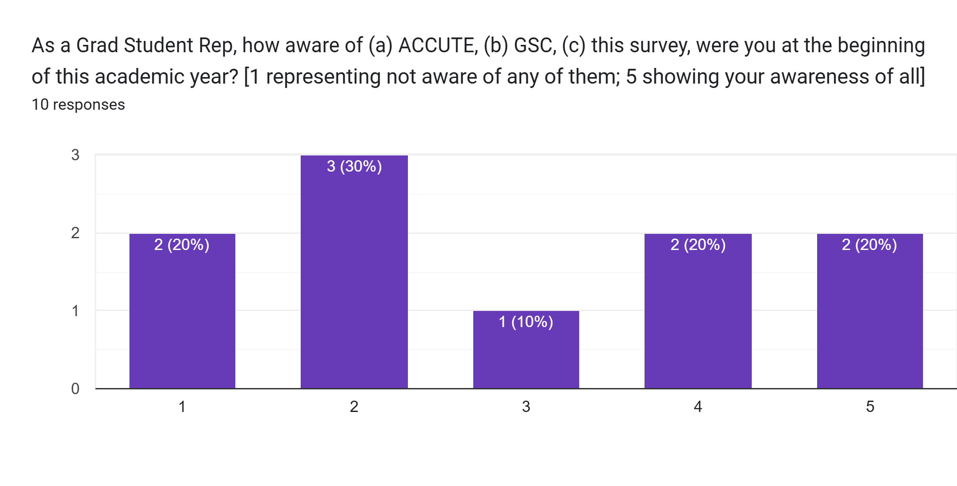
Notes:
Lot of new students as ACCUTE, new MA students

Slide 7
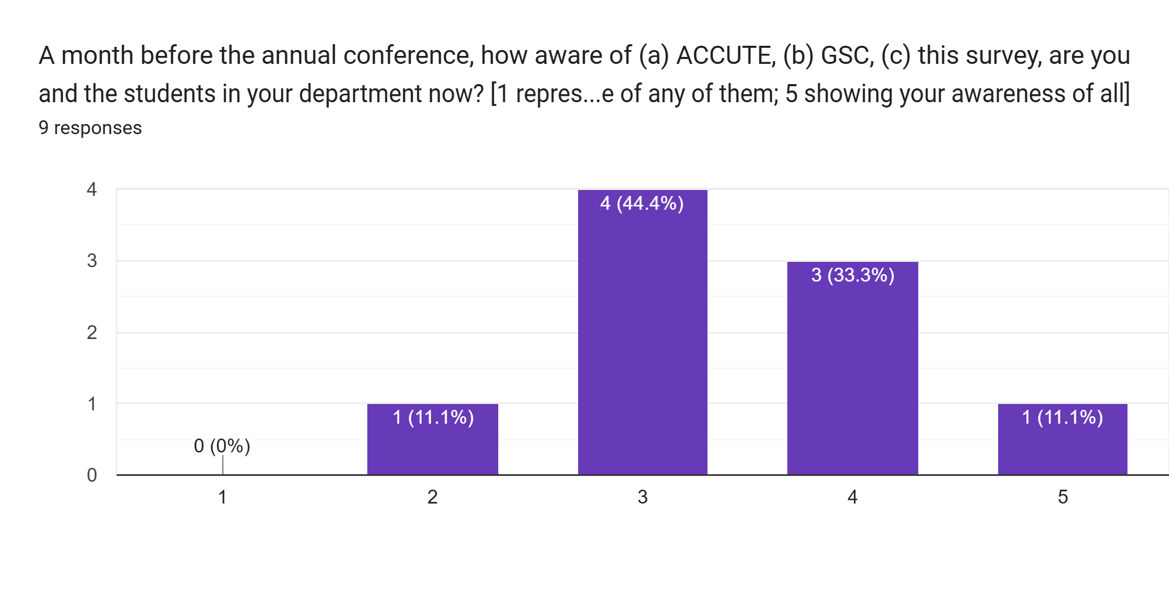

Slide 8
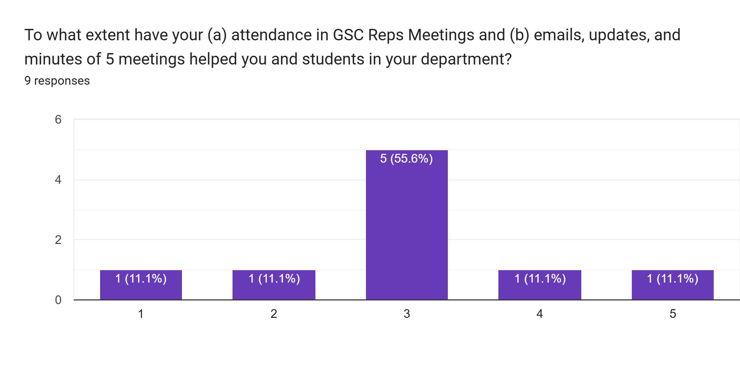

Slide 9
Reflection
We attribute the low initial awareness of ACCUTE compared to 2024 (when 60% rated themselves 4 (26.7%) or 5(33.3%)), to our gaining a large number of new members
However, we have seen a significant improvement in average awareness by the end of the year
The major policy change relative to previous years was a significant increase in average meetings, which have also been met quite favourably (77.8% at 3 or better)

Slide 10
In a few words, please briefly elaborate on how such communication has helped or not helped.
“The communication has helped in that I've been kept apprised of major updates -- but there's been less upset this year, and thus less to communicate widely.”
“Such communications has definitely helped, especially for those who will be attending the annual conference. At the beginning of the year, though, there was less communications and so I found myself having less to report back to the other students in my department. I was able to make the last few meetings and so have been able to pass that information around through my own department's graduate student council.”
“It's been nice to learn more about other graduate students across Canada and their relationship with the conference.”
“By reviving [Redacted] 's participation in the GSC, I have become more aware of networks and resources, allowing me to share information with my department.”
“As a student representative, I’ve often found that ACCUTE offers more opportunities than many students realize (including me). I believe these should be communicated early—ideally in students’ first year—so they can fully benefit. I am in my fourth year and still discovering how ACCUTE can support graduate students as an academic network. I recommend that ACCUTE develop a brief statement—ideally in bullet points—outlining how graduate students can best engage with the organization throughout their academic journey (which should be communicated in the first year of the academic program).”
“This has kept the lines or communication open, allowing for a place to ask questions and gain more knowledge about ACCUTE through peers”
“To my knowledge, I have not received anything at [Redacted] about ACCUTE though a graduate representative. All of my knowledge came from faculty who are members.”
“Honestly, I volunteered for this position last year but I wasn't really given any clear direction as to what I'm supposed to be doing. I was just dropped into it.”
“Have consistent communication has helped keep transparency between us and ACCUTE.”

Slide 11
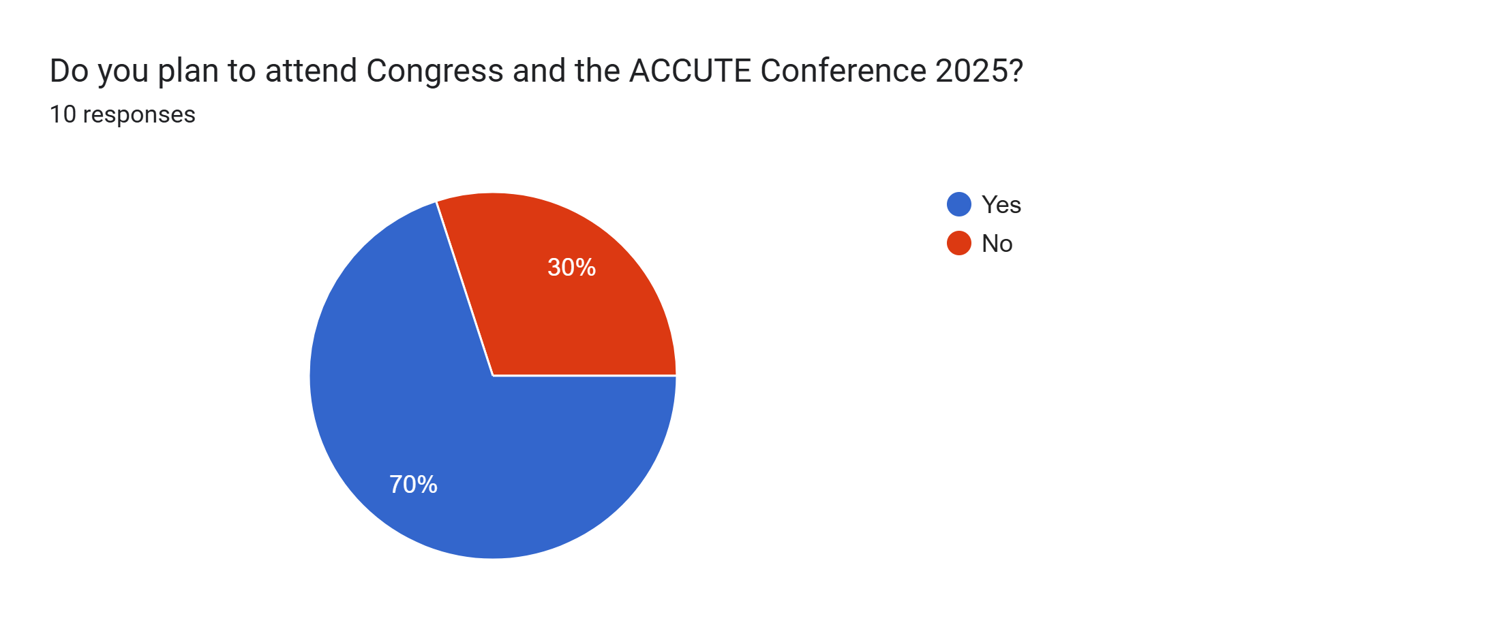

Slide 12
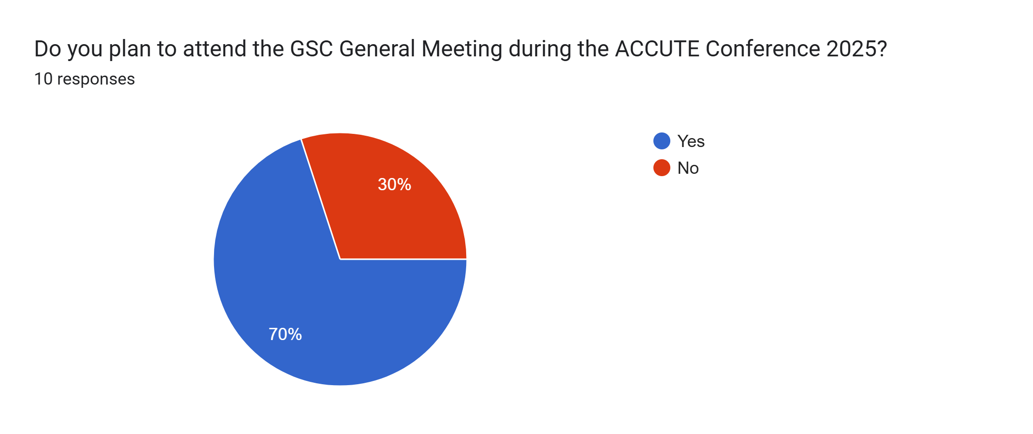

Slide 13
2. Graduate Student Well-being and Funding

Slide 14
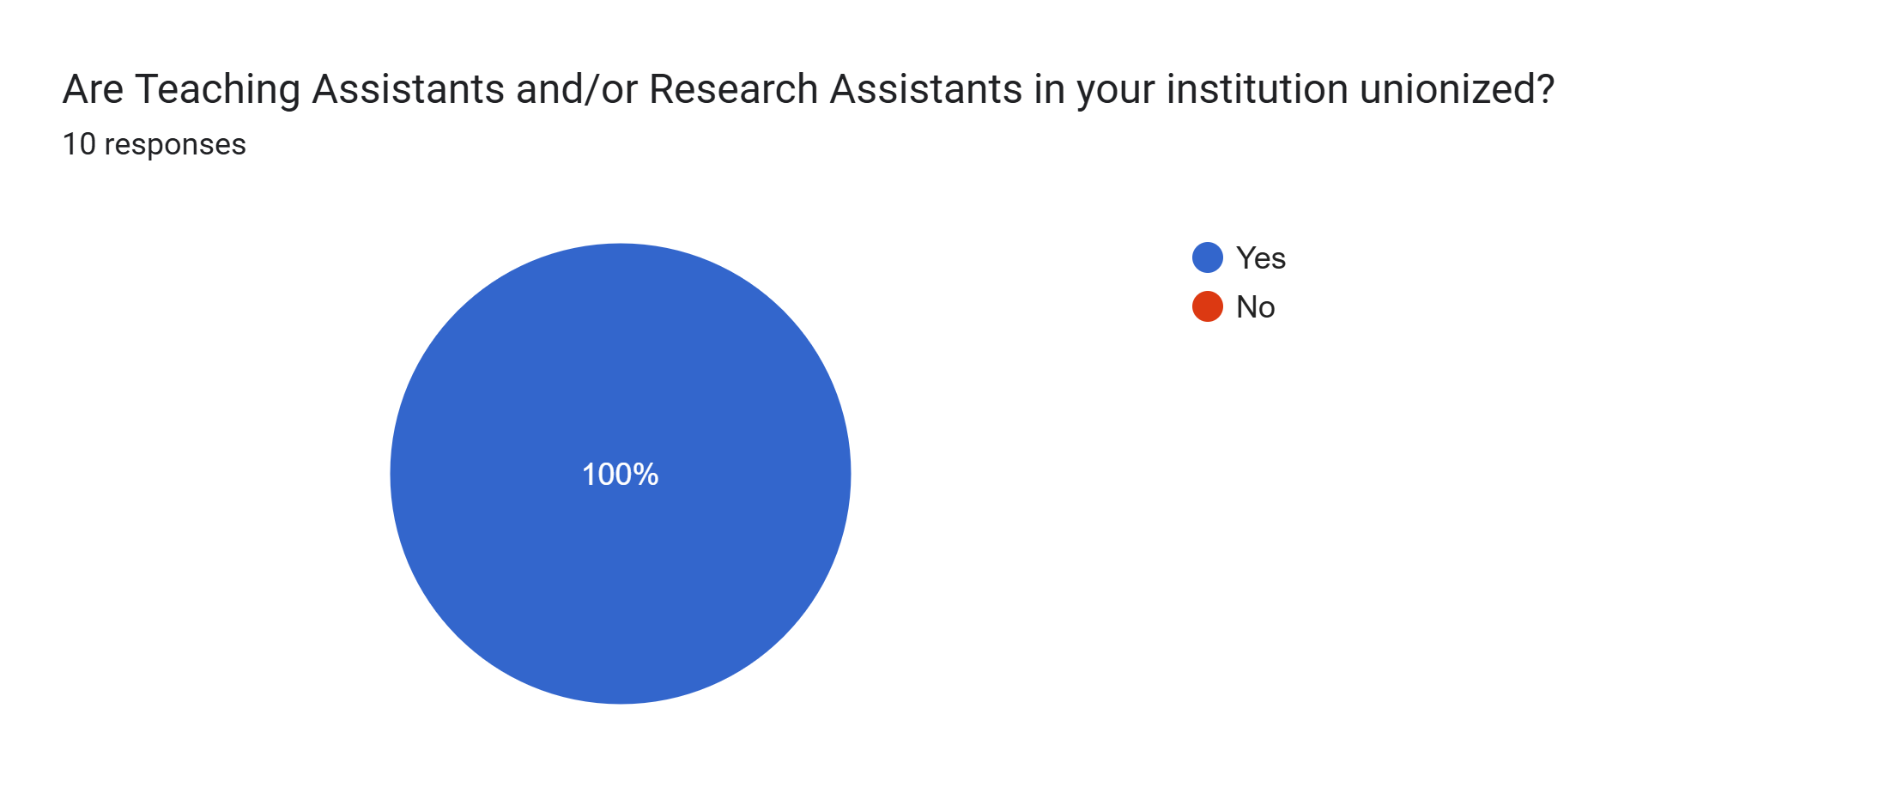

Slide 15
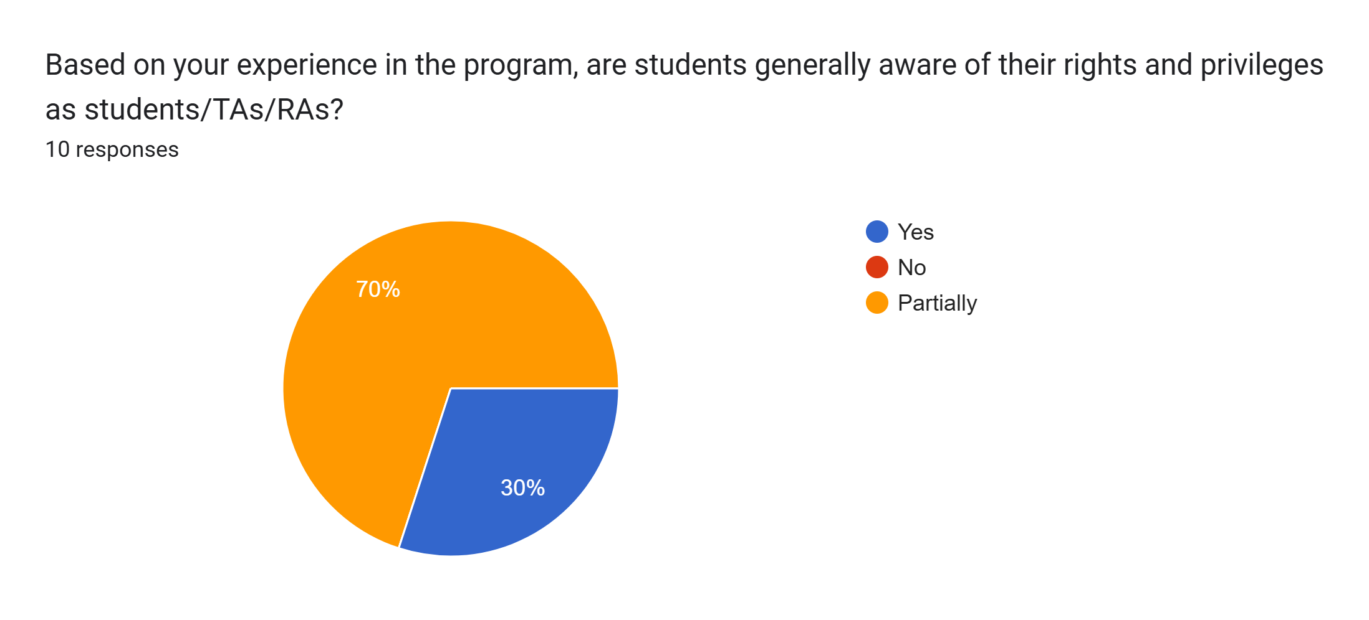

Slide 16
If you have chosen “no" OR "partially" in the previous question, please explain why. What do you think could help students be more aware?
I think that there is a lack of education from our union to new TAs about what our rights are -- generally we hear more from them around strike years. However, TAs talk to each other and spread information that way (informally)
Many MA1s and PhD1s are not introduced to the union or their rights as TAs until they become TAs (which they can only do in their 2nd year).
Perhaps because my institution has only recently (Jan. 2024) unionized TA positions, I and other students have experienced (and discussed) issues like an overly heavy workload. I may be noticing this especially as the union at my previous institution was more present and active on our behalf.
I recommend more direct involvement from the union through regular meetings with TAs, using plain and simple language to explain their rights, responsibilities, and the boundaries between their role and that of students, professors, and course coordinators. Personally, I encountered several situations where I was unaware of my rights and ended up carrying responsibilities that should have been handled by others. I sometimes worked beyond my allocated hours, fearing that objecting would lead to being perceived as inefficient or excluded from future opportunities. This significantly impacted my ability to meet academic requirements. Such clarity is especially crucial for international students, who, unlike domestic TAs, may not be familiar with institutional policies and rights in a Canadian institution due to their different educational and cultural backgrounds.
The information is available, but students willingness to become active in a union in which they study for two to four years varies.
More direct communication with the organizations that represent them. We get a fair amount from the [Redacted] Student Union, but most don't know about ACCUTE, and CUPE sort of operates without much communication with grad students.
I think when it comes to responsibilities in the contract, depending upon what is asked of them- I think that in the English department professors are pretty good about making sure things are fair but I do know of cases with the film studies course where there had been questions last year. The union took care of it, though.

Slide 17
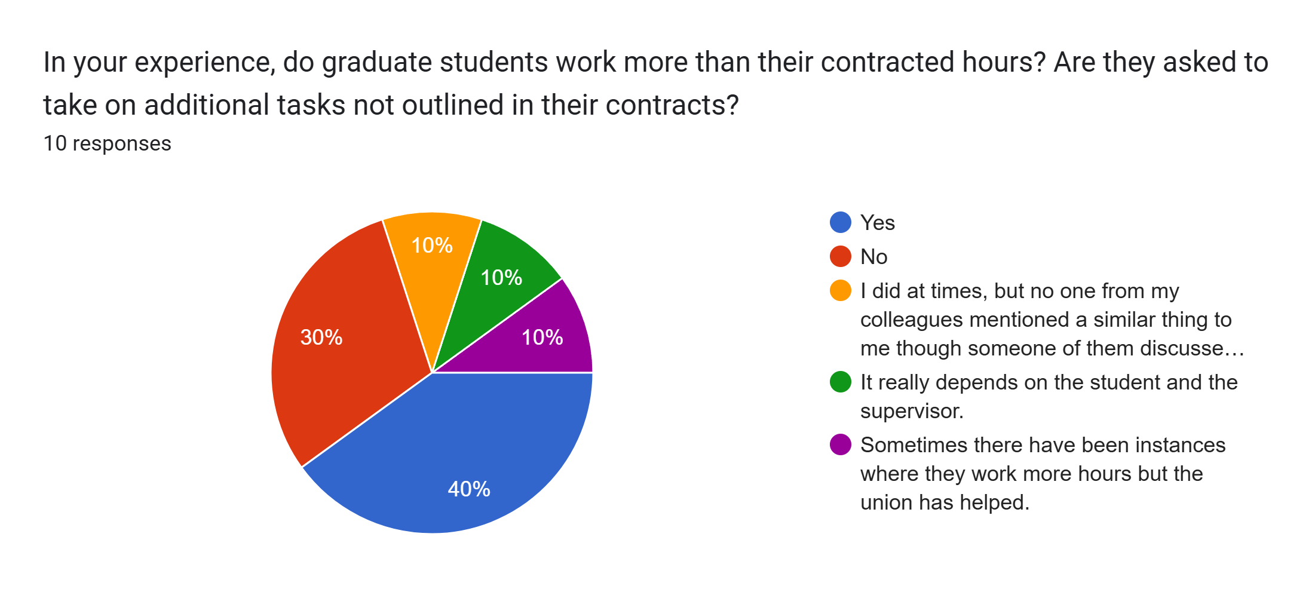

Slide 18
What is the average funding period for graduate students at your institution? Is funding adequate for student needs? Part 1.
MA is 1 year; full funding for PhD is 5, with an option to take on TA work in the 6th if positions are available. However, positions are less available now than they have been. I do not think funding is sufficient.
The average funding period is 4-5 years, but many end up stretching their graduate degree longer, as our department has a number of students who work other full-time jobs or have caregiving/parental responsibilities. Since our university is situated in an area which has a relatively low cost of living, most students I know are able to make their funding work, but it is definitely tight and not always adequate to support students' needs.
4 years for PhDs. (last year is only $5000)
While the PhD program is officially four years, this timeline is often unrealistic—especially for international students navigating the pressures of a new culture and academic system. In reality, I don’t know anyone who has completed within that timeframe of four years. Many students are under significant stress and must carefully strategize every aspect of their academic engagement just to make steady progress on their dissertation. This highlights the need for more institutional flexibility and support that reflects the actual experiences of graduate students.

Slide 19
What is the average funding period for graduate students at your institution? Is funding adequate for student needs? Part 2.
SSRHC is the main way graduates receive funding and is dispersed in three checks spaced out of the course of a given year. There is often no funding in the summer.
Two years MA / four years PhD
We are typically funded from September to April. As far as funding for MA students goes, the funding has failed to keep up with inflation and is not adequate. This is partially due to the time it takes to argue new contracts through CUPE, and the very slow incremental increases that those new contracts bring us. Essentially, inflation has greatly outpaced funding and as such many MA students are forced to work a job alongside their GA and research duties.
September to April - no. No one can live on 1500.00 a month

Slide 20
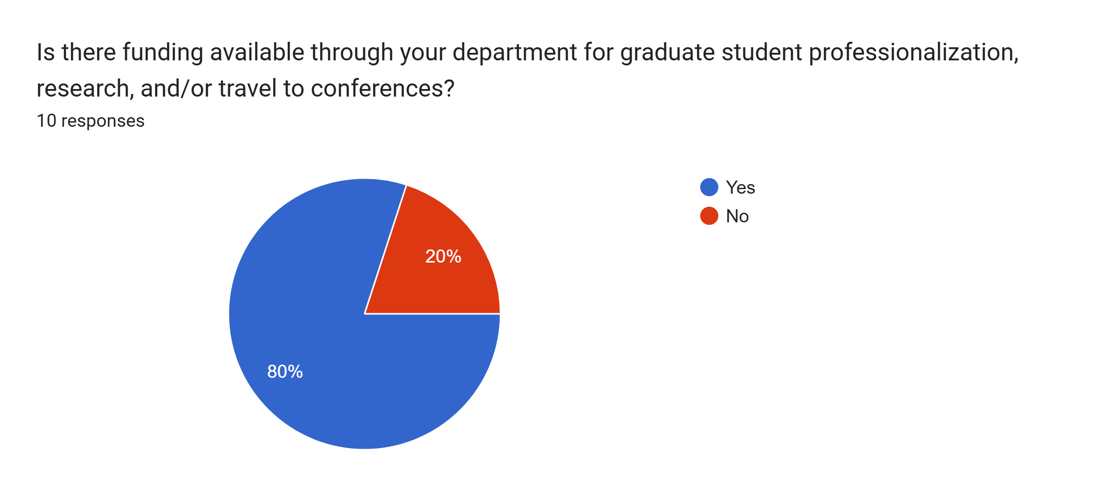

Slide 21
Available funding opportunities for graduate student professionalization, research, and/or travel to conferences. Part 1
There is funding available from the larger Faculty of Graduate studies and through our CUPE union.
Our department has a $300 travel award for students travelling for conferences and then students are also able to apply for another $500 travel award which is distributed through the College of Graduate and Postdoctoral Studies.
very little, $1500 for our whole time as Ph.D.s
There are funding opportunities available through the Faculty of Arts, though not through the English Department. I have not yet applied for this funding personally, but from conversations with students and faculty, understand that it is extremely limited.
To the best of my experience, the department has supported students by covering costs for travel, accommodation, and membership in conferences and associations. However, this support is not always comprehensive or consistently available.

Slide 22
Available funding opportunities for graduate student professionalization, research, and/or travel to conferences. Part 2
There is funding available for all of these if the proper avenues are utilized. These processes are transparent.
PD funds through CUPE. Conference funding through TGSA. Travel bursaries. Funding through departments on need basis.
This funding is typically offered to us through awards and bursaries, as far as I'm aware.
Travel budget offered by the department, funding available by application to the Graduate Student Association for travel
800.00 each year for travel/conferences

Slide 23
As far as you know, how many grad students have additional employment in addition to OR outside of Teaching/Research Assistantships? Part 1.
It is hard to answer this question, but I know that there is not a small number of students who would do this, particularly at the master's level.
I am not sure of the exact number, but I personally know a handful of students (about five) who have had to work or continue to work outside of or in addition to Teaching/Research Assistantships.
I would say most everyone. The funding provided at [Redacted] is generally enough to scrounge by. Working a job on top of being a student is nearly mandatory/
Of the number of grad students I know in the department, many have either an additional part-time job or a paid co-op placement.

Slide 24
As far as you know, how many grad students have additional employment in addition to OR outside of Teaching/Research Assistantships? Part 2.
I am afraid that students may not share this information.
In the summer, a good deal. Otherwise, not many to my knowledge
Many. Funding no longer appropriate to cover costs without a larger grant I'm play.
If I had to ballpark it, based on my own knowledge I would say close to 90%.
I don't know percentage but quite a few of us have jobs outside of TAships.

Slide 25
Roughly, what percentage of graduate student enrollments constitute international students? Is their funding at par with domestic students? Part. 1
Generally, the PhD program and MA students admit 1 or 2 new international students a year. They receive an additional TAship over the summer, but otherwise it is my impression that their support is generally equivalent to the domestic students in that both categories of students are underfunded.
About 20% of graduate students in our department are international students. I am not sure if their funding is on par with domestic students. It looks like they are eligible for the same $20,000 minimum funding package as domestic students, but have to pay much higher tuition.
Of our Ph.D1 cohort, 3 of 7 students
Our targets are for 50% International and 50% domestic. It doesn’t always work out that way but that is the aim. Funding is tied to tuition. For both domestic and international students the funding basically covers tuition, though because international tuition is higher than domestic, the funding amounts reflect the difference. The basic point, however, is that both domestic and International; students receive funding necessary to cover tuition.

Slide 26
Roughly, what percentage of graduate student enrollments constitute international students? Is their funding at par with domestic students? Part. 2
20-30%. There funding is less.
10-25% historically. Not sure this year. Can not comment about funding, but even if it is the same, the expenses incurred are higher for international students.
I am unsure.
According to the numbers I got from the department in Summer 2025, [Redacted] has 72 students enrolled (MA and PhD). Of those, 10 are international, 6 are permanent residents, 56 are domestic. All international students this year are PhD students, and international PhD students get the same amount of funding as domestic students, and pay the same tuition as domestic students. They do get $600 more in WGRS than domestic students to cover their additional UHIP costs.

Slide 27
Reflection
There is a misalignment between Faculty and Students on the number of hours worked relative to contract expectations
However, faculty and students agree funding is insufficient
Many also discuss beliefs that funding timelines are unrealistic (This is supported by comments from the faculty survey, wherein 71.5% have expected completion times of 5 years or less, but only 28.6% completed before this time)
There is generally a degree of funding for conference travel, however many, both student and faculty, find it limited

Slide 28
3. Course Diversity

Slide 29
Do you consider that the grad courses offered reflect the diversity of the student body in your department? In other words, what is the make up of your grad student community? Does it comprise students who identify as members of the BIPOC and LGBTQ2+ communities? Are offered courses in alignment with students' interests?

Slide 30
Part 1.
I think, in general, the courses do reflect some of the interests of the student body, in that there are courses offered in, for example, post-colonial studies. However, there is no requirement that students take one of these courses the way there is for taking a pre-1800 works course.
The grad courses align to some degree with the diversity of out student body. The biggest issue is just that with a small department, we are only able to offer seven graduate courses per year (and one of those is the mandatory "research methods course) so this means that students have virtually no choice in taking courses that align with their interests. Out of the six courses (of which most graduate students have to take five) students could choose to take this year, there was one diasporic literature class and one Indigenous literature class as well as a course on Canadian literature in which we read works by BIPOC and LGBTQ2+ authors.
I would say generally yes. About half of courses reflect "traditional" English classes in long established fields and the other half are topics (typically much more interesting) related to cultural studies topics.
No. I and other students have raised concerns with the department about the very narrow course offerings this year. Many (possibly even the majority) of students have been disappointed by the course selection, and the cancellation of courses they wished to take.
Yes, our student community is highly diverse in this regard. The courses reflect BIPOC knowledges and discourses to a certain extent.

Slide 31
Part 2.
Many of the students identify with said communities, and we feel that the university should do a better job of reflecting this in course availability.
Yes, we have a relatively diverse community (especially compared with the [Redacted] population). I would say that efforts have also been made to diversify and decolonize curriculum, but it I a work in progress.
Our course selections here are pretty limited, but [Redacted] does try to offer a variety of courses that represent multiple interests and identities. There could be more though.
Yes, there are a large proportion of LGBTQ+ students, as well as BIPOC students. Course offerings are fairly diverse and reflect the interests of these students.
No. There has been a lot of discussion about the lack of diversity in the graduate courses offered in the English department.

Slide 32
Any information about your department's/institution's wellness and mental health initiatives catered towards grad students?
The department does not offer any wellness or mental health initiatives that I know of. The Faculty of Graduate Studies does offer some, but I do not know how well attended they are.
Earlier this year, we had a seminar devoted to "Work and Wellness" where a campus mental health nurse came into our professionalization course to speak about mental health resources and services available to graduate students.
Many of these initiatives are organized by the Graduate English Department itself. There could definitely be more from the department itself and they could be more specific.
Sure. I think that there is a gap in policy and practice. While policy and PR states that health and well-being are important, budget cuts, cuts to funding, and precarious labour practices do not put health and well-being as priorities.
I have not heard of any that are catered directly towards grad students, unfortunately. We do have initiatives that are aimed at the entire student body though.
Counselling and medical appointments are available on campus. An email newsletter dedicated to graduate wellness and events is available for sign up. GradChats is a drop-in biweekly discussion circle for graduate students on various topics, including the supervisory relationship, imposter syndrome, and financial anxiety.
Workshops are sometimes offered. The GES has a wellness rep who tries to hold yoga workshops, etc.

Slide 33
4. Space, Services, Socialising

Slide 34
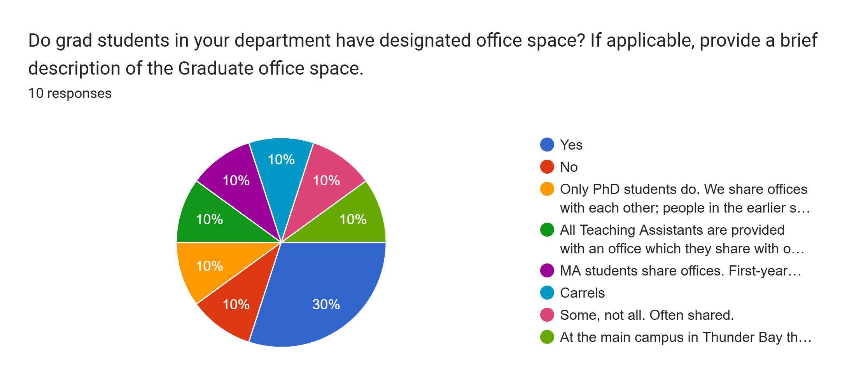

Slide 35
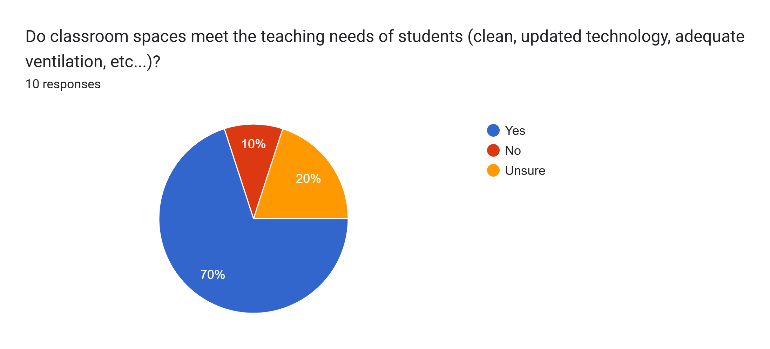

Slide 36
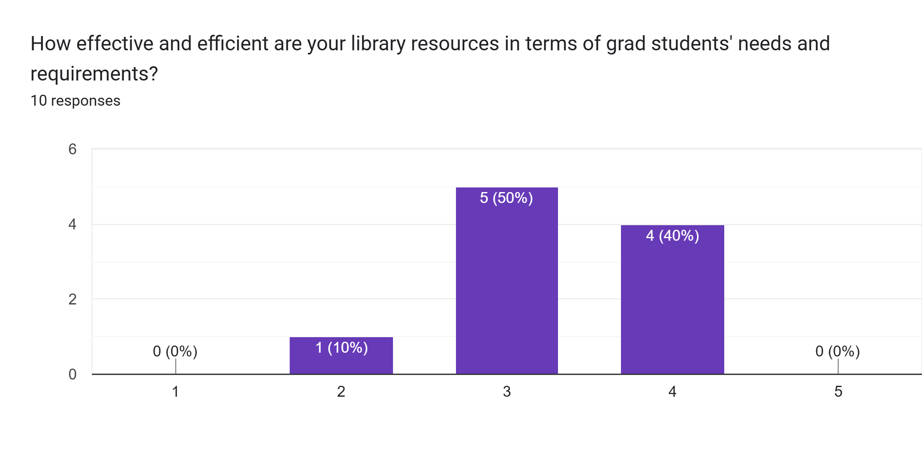

Slide 37
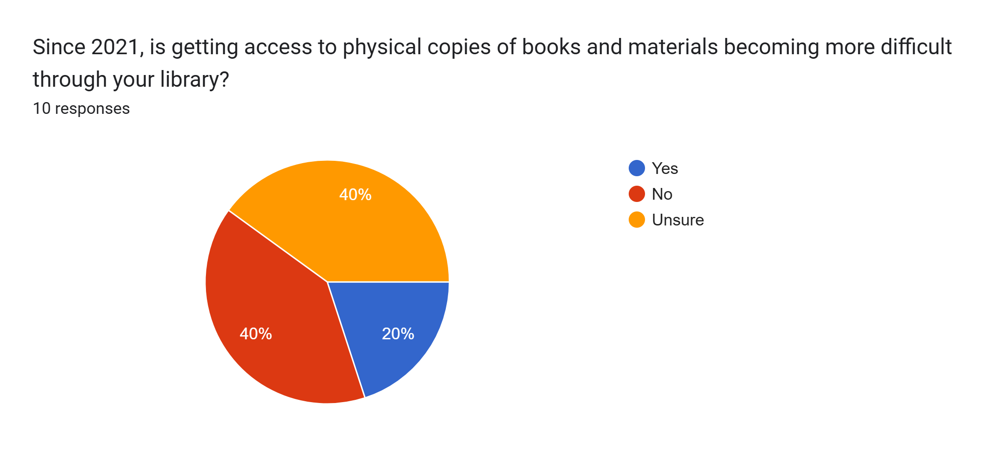

Slide 38
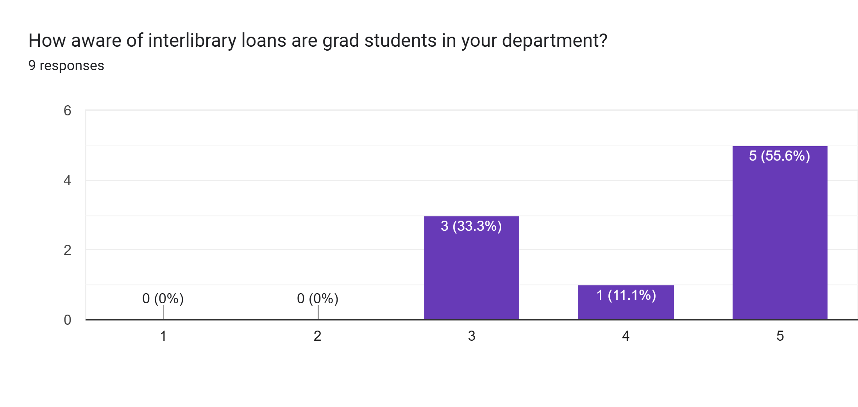

Slide 39
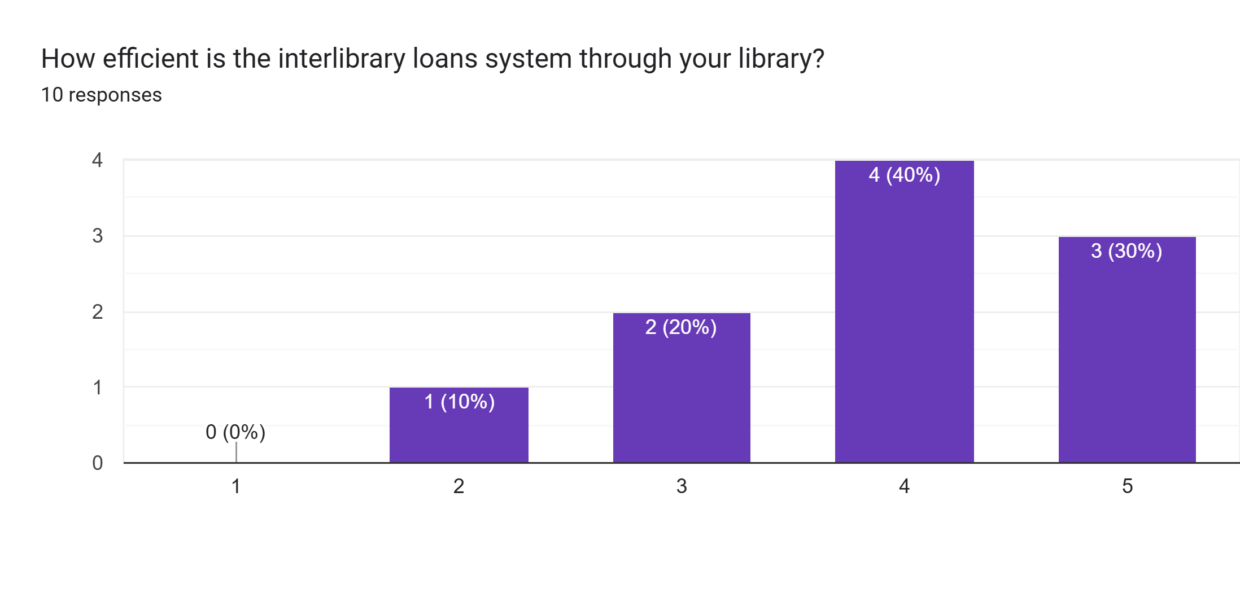

Slide 40
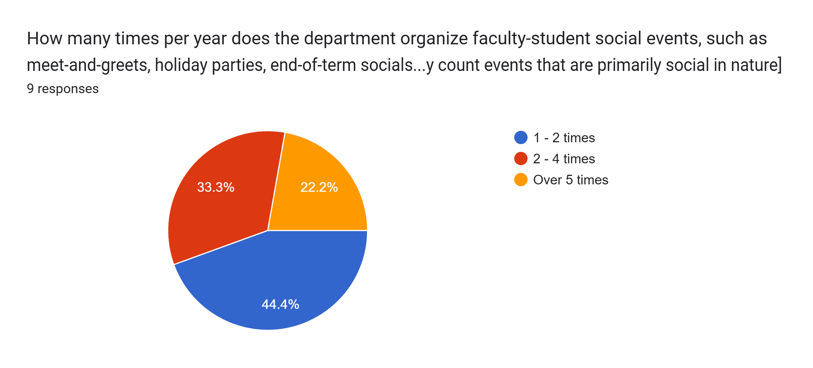

Slide 41
Would you like to share information regarding other events for grad students in your department/institution?
I have selected 1-2 faculty student social events above because there was no option for 0. To my knowledge, these events are not held.
We have had a few events over the course of the year, including a department Christmas party, reading week write-ins, an off-campus trip to a museum as well as an end-of-term social.
[Redacted] does little to connect students and faculty, the two often feel very separate.
Our English grad student society is active in organizing academic and social events for grad students each month.
We meet for dinner to celebrate the graduation of students, a call set by our GPD.
All types of events that we have are listed above
No comment here. [Redacted] is good at having events, however these have also been subject to budget cuts and are not as frequent or elaborate as in the past.

Slide 42
5. Professionalization and Hiring

Slide 43
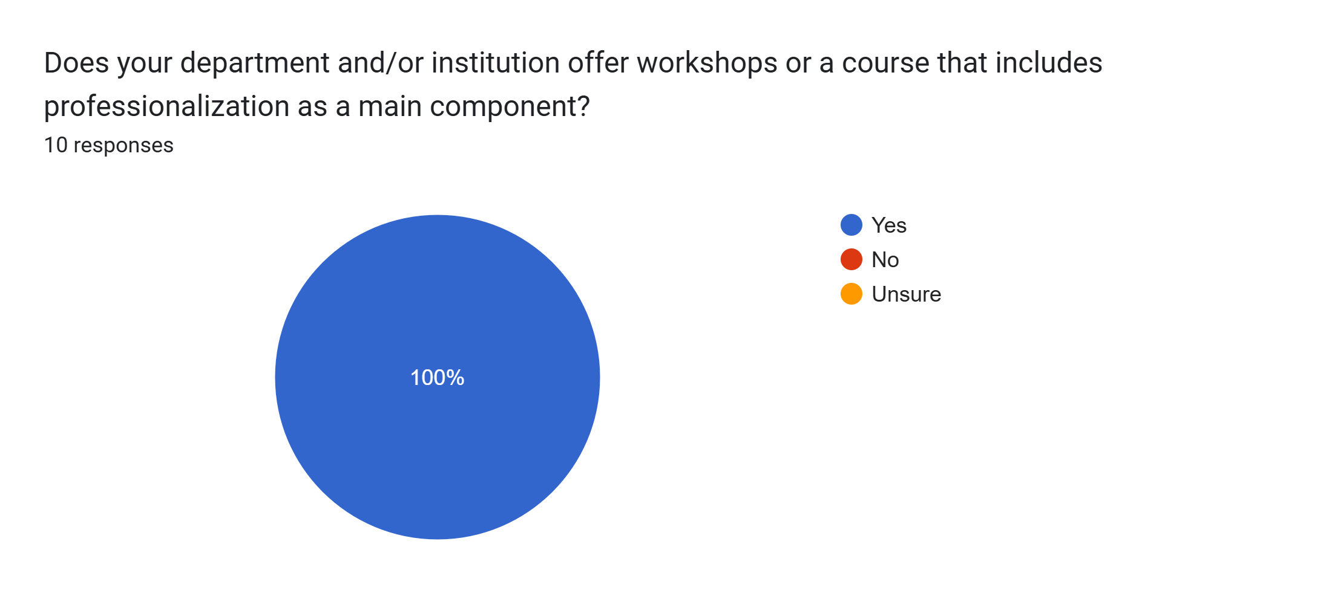

Slide 44
What kind of workshops gets offered? Please provide some details briefly. Part 1.
Teaching Skills, Applying for Funding, Writing Across Genres, Academic Conferences and Publication, Alt-academic career paths, The Academic Job Market, Comprehensive Exam Preparation
We have monthly workshops on a variety of topics from applying for SSHRC funding, teaching resources, conferencing, navigating the non-academic and academic job markets, developing research plans, academic publishing, field examinations, postdoctoral fellowships.
The department offers 16 hours of training which offers priority for TA hirings in the fall. I've had problems with this system and have gotten the union involved because it basically functions as free training before anyone has a work contract. Working with the union, we are hoping to get these hours covered by a contract.
Workshops on various subjects like on how to teach adults, etc.
Workshops on grant and proposal writing, publishing academic work

Slide 45
What kind of workshops gets offered? Please provide some details briefly. Part 2.
These courses are for TAs specifically and cover working in a union, conduct, and general professionalism.
Employment after graduation, writing and research, studying for comps.
There is a mandatory professionalization course in the winter term of Year 2 of the PhD.
There are a lot of workshops and initiatives around knowledge mobilization for graduate students, which easily carries over into non-academic careers. Examples include Mapping New Knowledges, Three Minute Thesis, GradFlix, and the workshops provided to help support students' participation in these things. The Centre for Pedagogical Innovation offers extensive TA training/development opportunities that also provides transferrable skills to other workplaces.
The Graduate Development & Placement Coordinator Kate Stanley has been doing an exceptional job at partnering with the different departments at Western to coordinate workshops on jobs in the humanities. She also started a course which is all about working in the humanities.

Slide 46
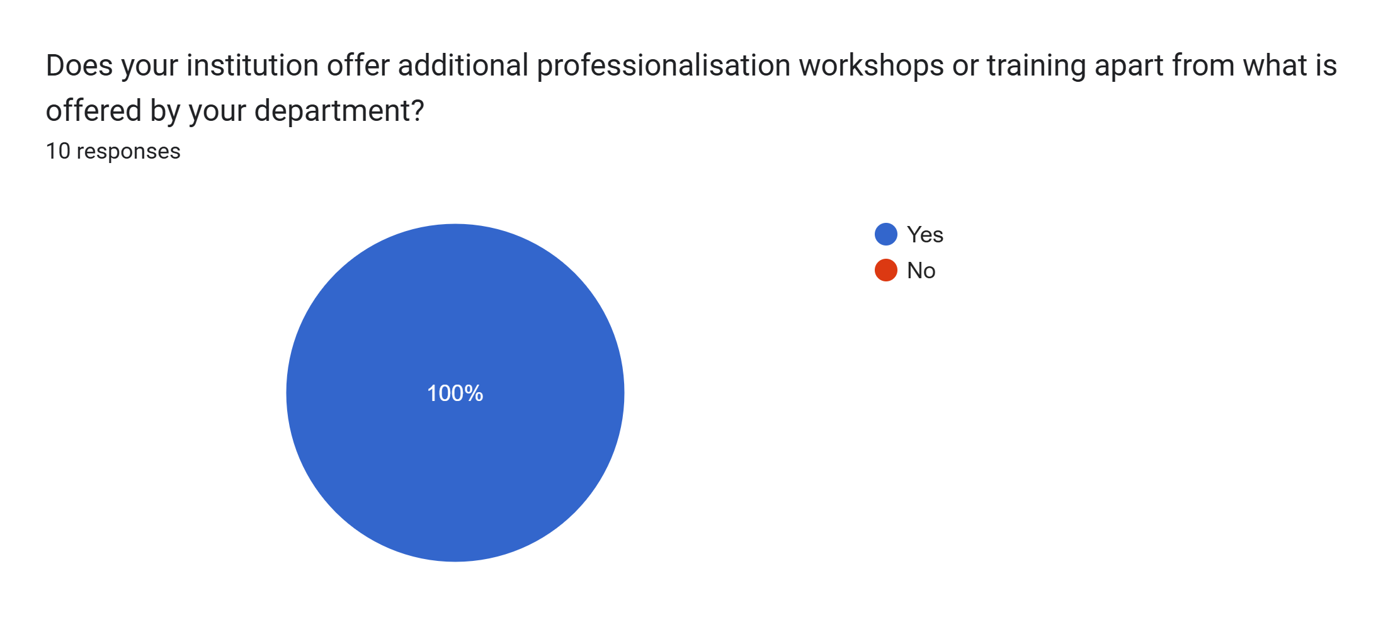

Slide 47
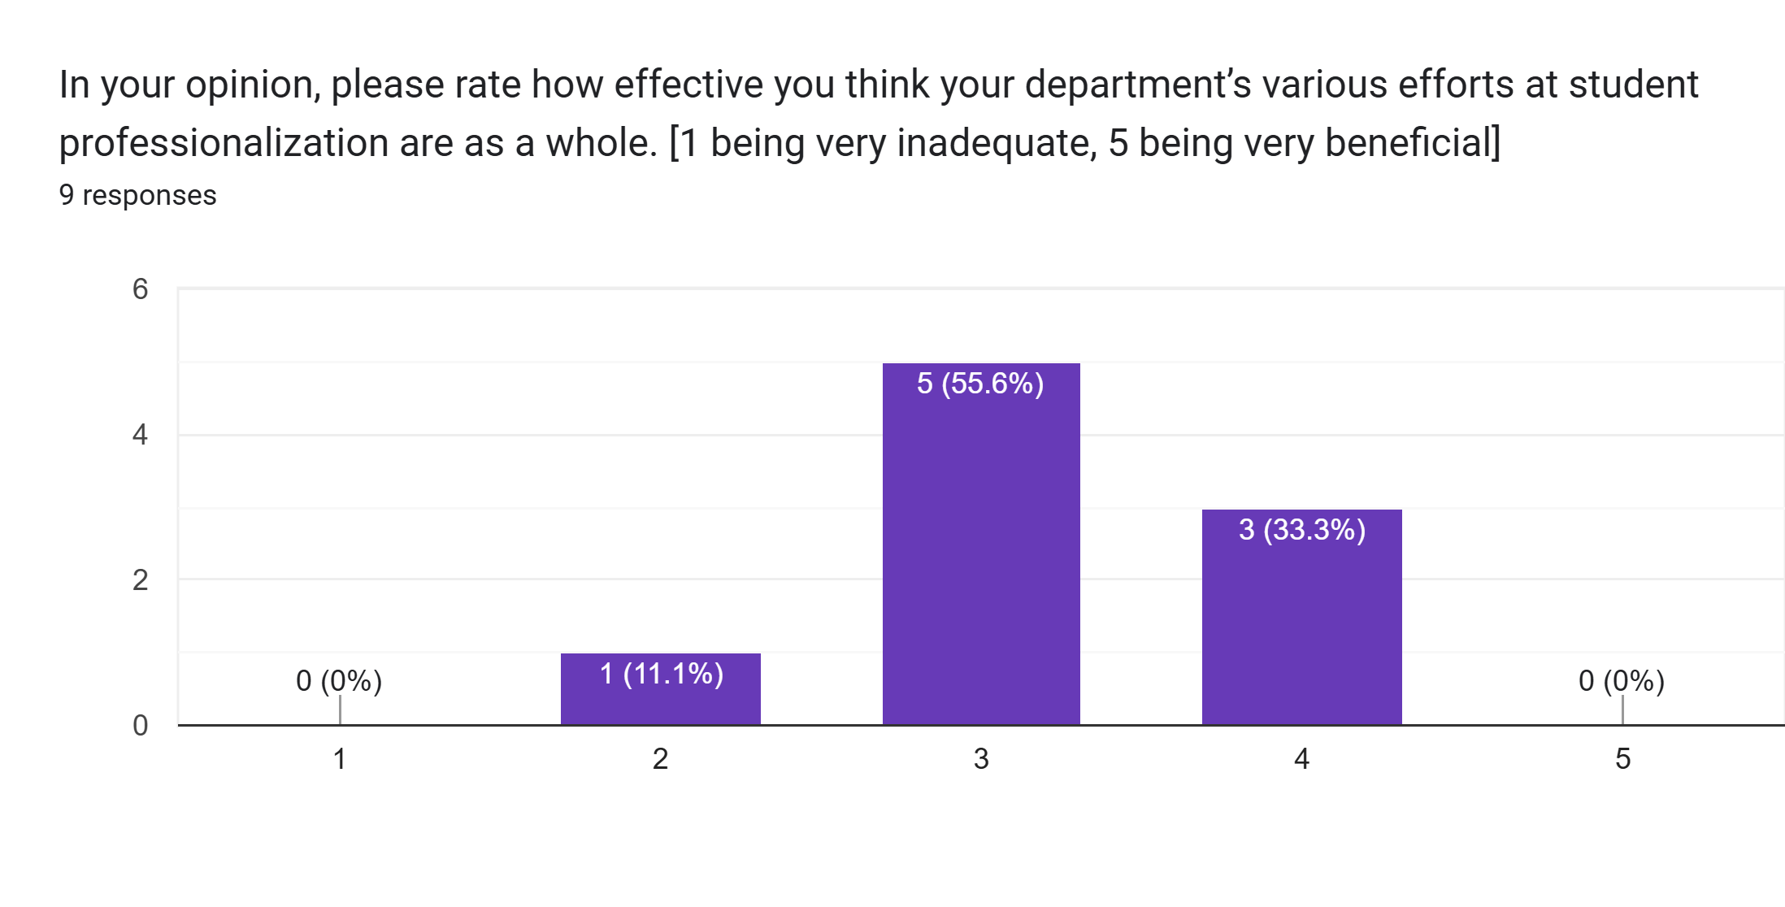

Slide 48
What could your department do better to improve professionalization or create opportunities for students? Part 1.
The professionalization workshops could be structured in a way to be more practically engaging. Currently, they are essentially mini-lectures followed by a Q&A, with very little practical activities involved.
I think our department is doing quite well, but a way in which they would do better is to provide more concrete details and skills like how to make resumes, apply for positions, etc.
[Redacted] offers a lot of opportunities for "professionalization" training. There is a lot more on offer to help students learn to translate their experiences and skills of grad school into other contexts. Those opportunities aren't often taken up by students (and I don't think this would be unique to [Redacted]. I think this is in part because grad programs are so intense, that unless the supervisor or GPD/or supervisor? require/expect/encourage student participation in these opportunities, students miss them. In some cases, perhaps, they may even be seen as a distraction from the student's "real" work of research and courses. Sometimes, too, it can be because faculty are not aware of what is out there. Communication between the University and students can be extremely challenging -- there is so much messaging and so many emails that it's hard to get students' attention on your event/workshop, etc. So the opportunities are there, it's just a multifaceted problem of getting students connected to them.

Slide 49
What could your department do better to improve professionalization or create opportunities for students? Part 2.
More targeted and specific opportunities and promoting more of them
Do something about the sessional trap
Advertise them in a way that more students see them.
Additional workshops or information on careers after graduation, within academia or not.

Slide 50
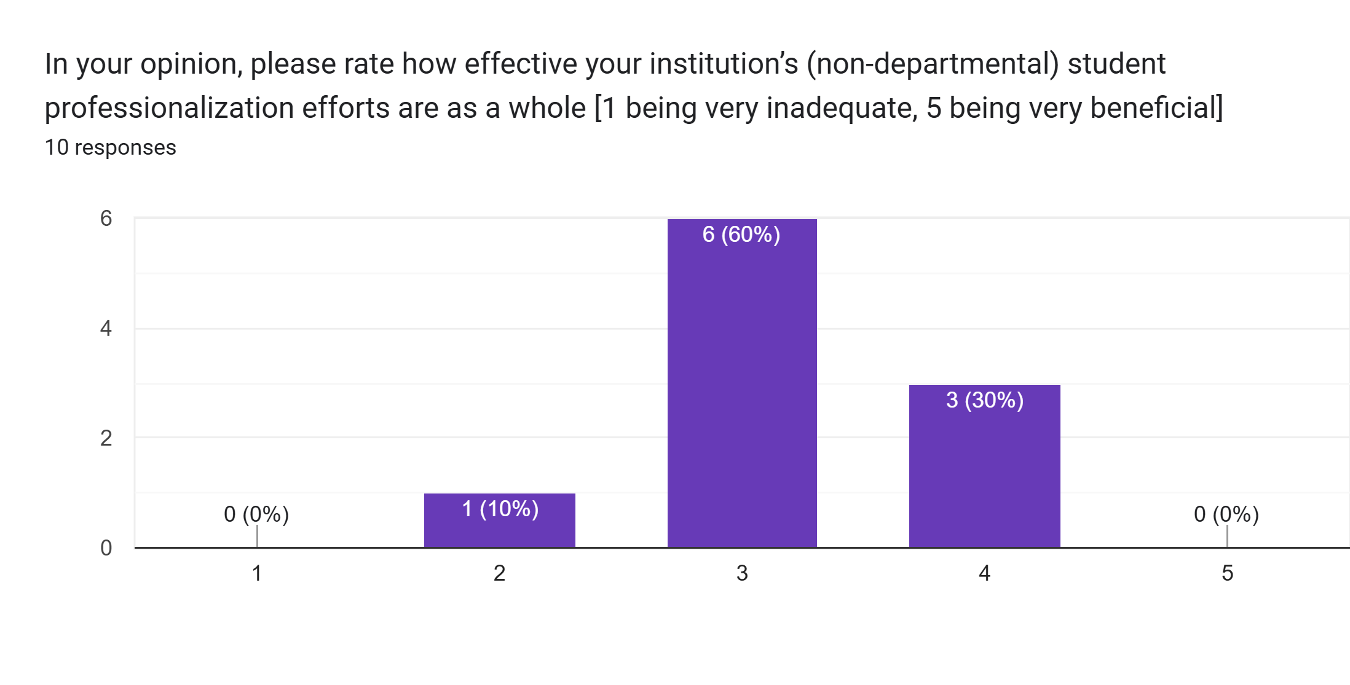

Slide 51
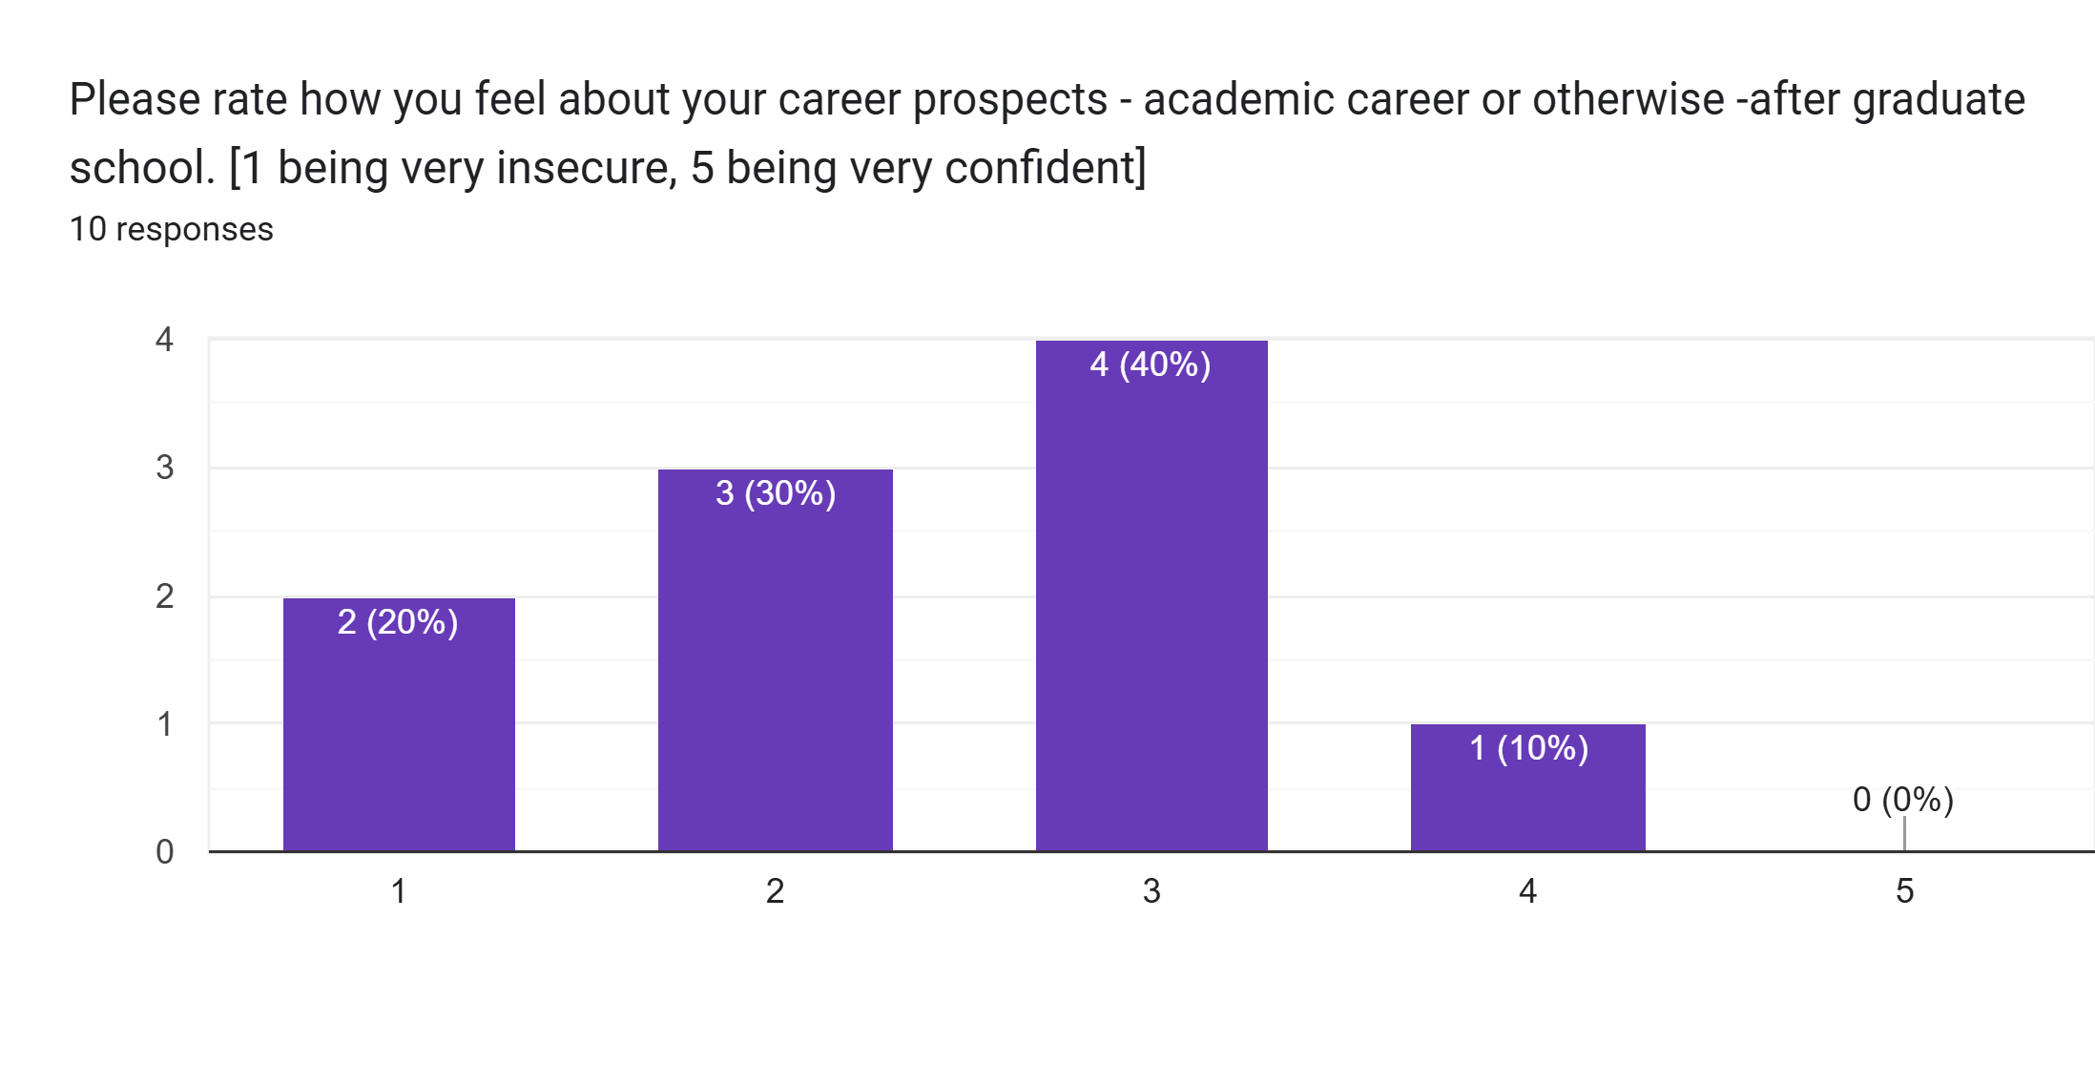

Slide 52
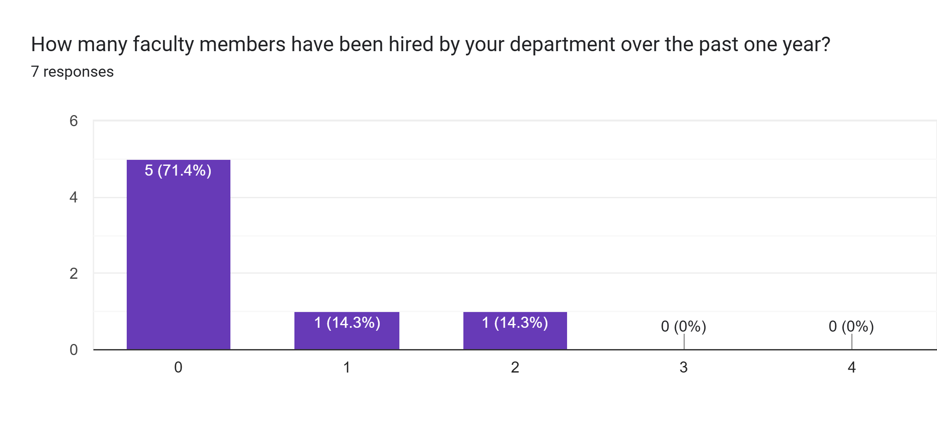

Slide 53
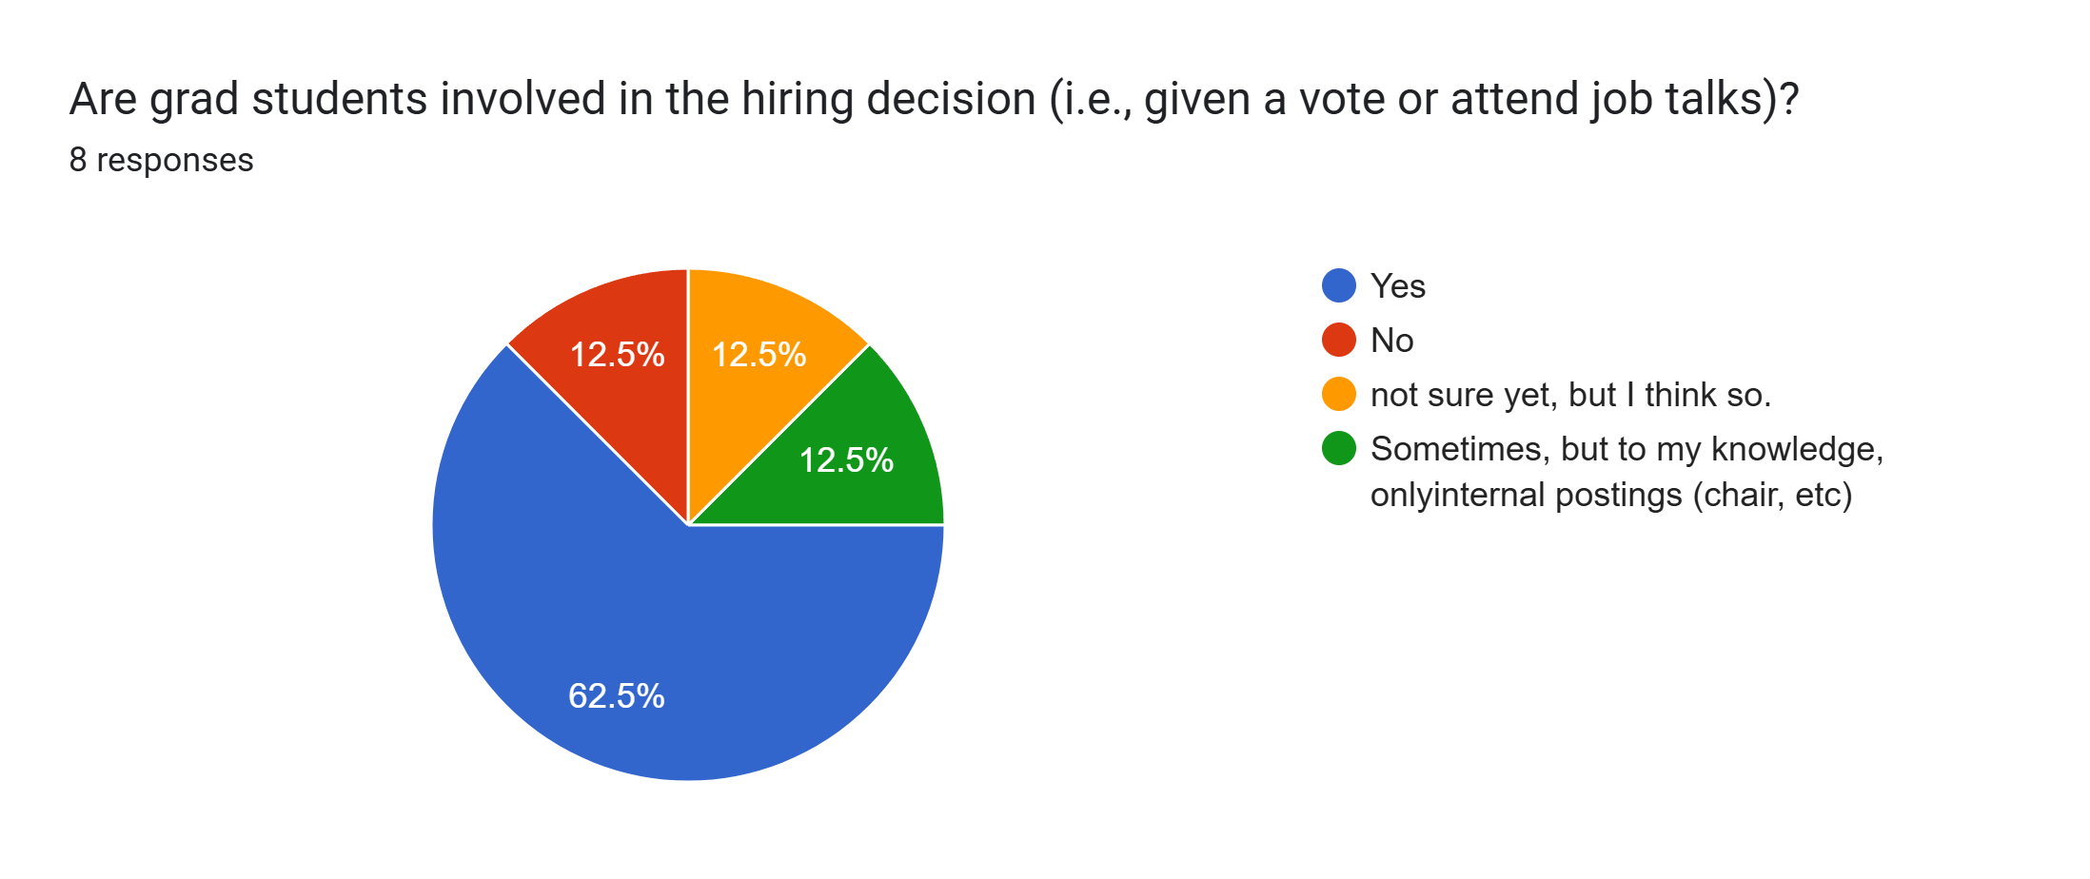

Slide 54
Would you like to share anything else about professionalization and hiring in your department?
Grad students do get to attend job talks for new hires.
Not at his time

Slide 55
6. Responses and Comments

Slide 56
any further comments or concerns relating to this survey, ACCUTE, and/or the GSC? What else could this survey include?
No concerns.
I think the survey could go over how aware students are of ACCUTE specifically a bit more
Graduate student relationships with department and supervisor. Ability for schools to assist students in timely completion of their degrees.
Some of these questions remain unanswered given the timeframe in which I have been the ACCUTE Representative for [Redacted] 's English and Cultural Studies department (approximately 2 weeks at the time of writing).
Perhaps something next year on funding. We need more transparency on SSHRC and OGS

Slide 57
Please describe any specific problems or concerns that graduate students in your department face that are not covered by this survey.
I just wanted to say that I've enjoyed being an ACCUTE delegate. The only that might be helpful to change would be some kind of on-boarding process. I wonder if a Word doc could be created and sent out to new ACCUTE delegates that gives a brief overview of the position and the role of the GSC within ACCUTE? It could be used every year as the position tends to transfer from year to year.
Funding is an ongoing stressor
Nothing at this time.

Slide 58
Faculty Responses

Slide 59
I. General Graduate Program Information

Slide 60
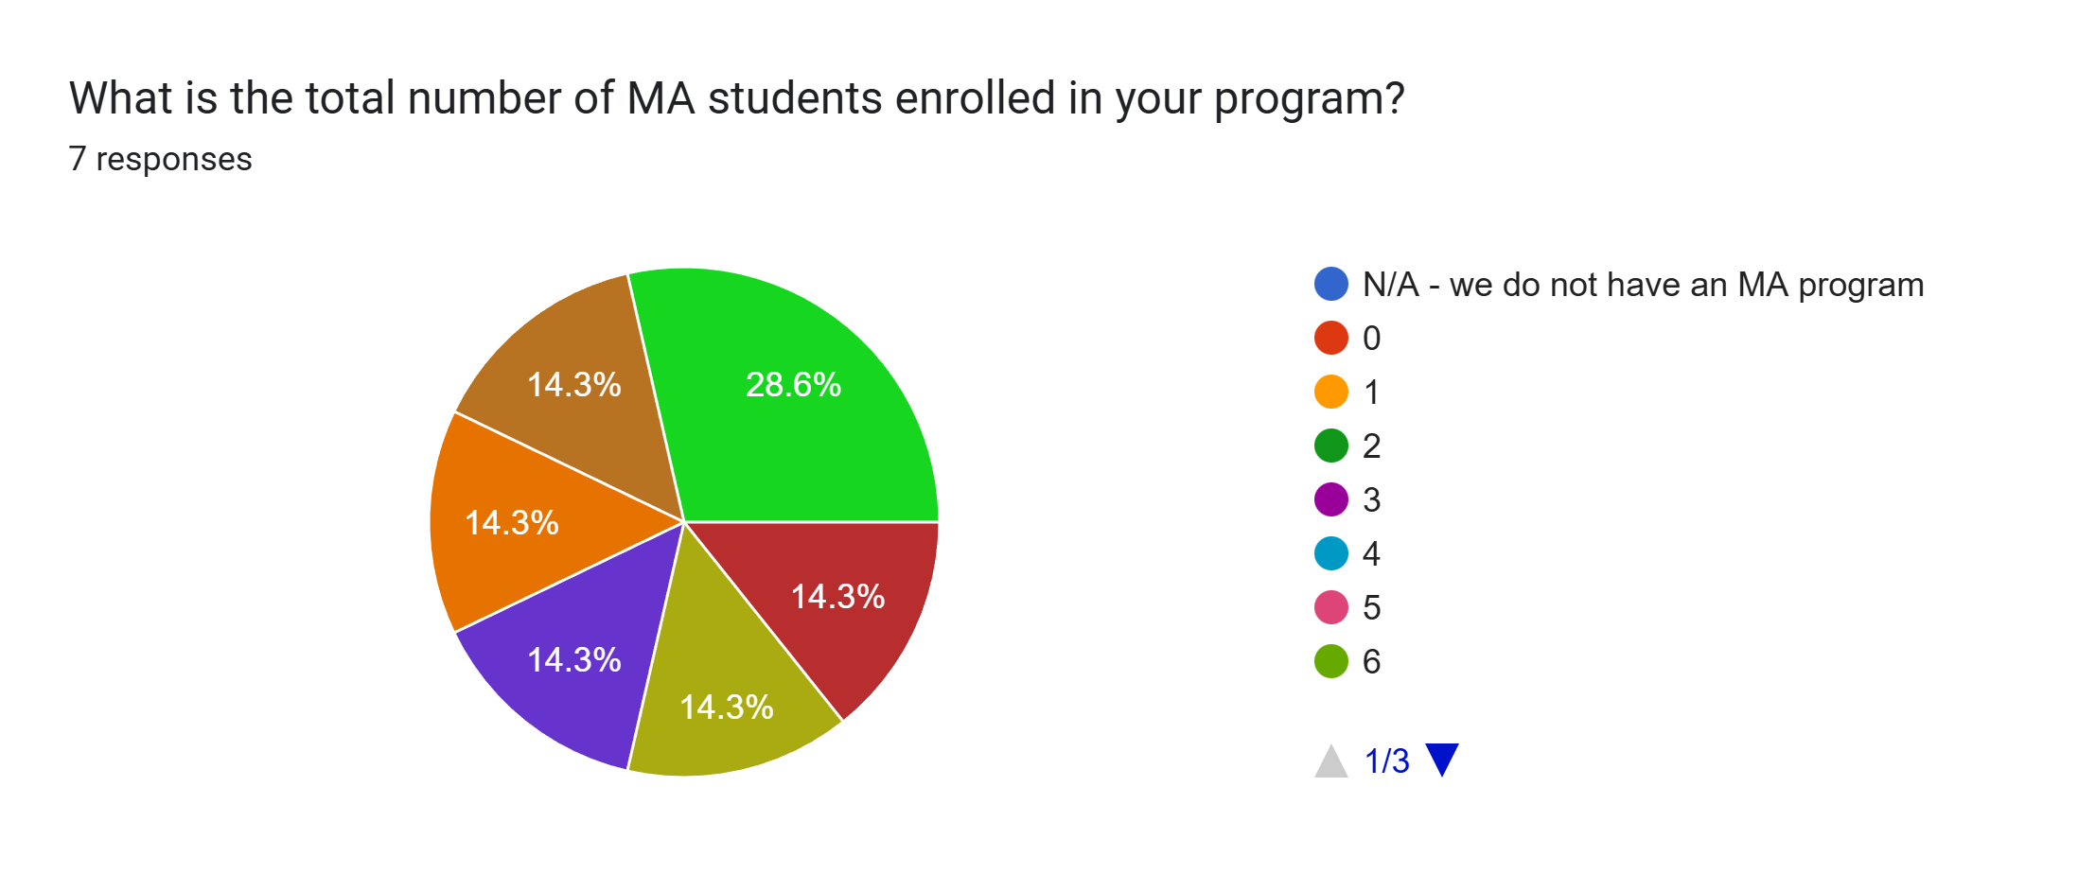

Slide 61
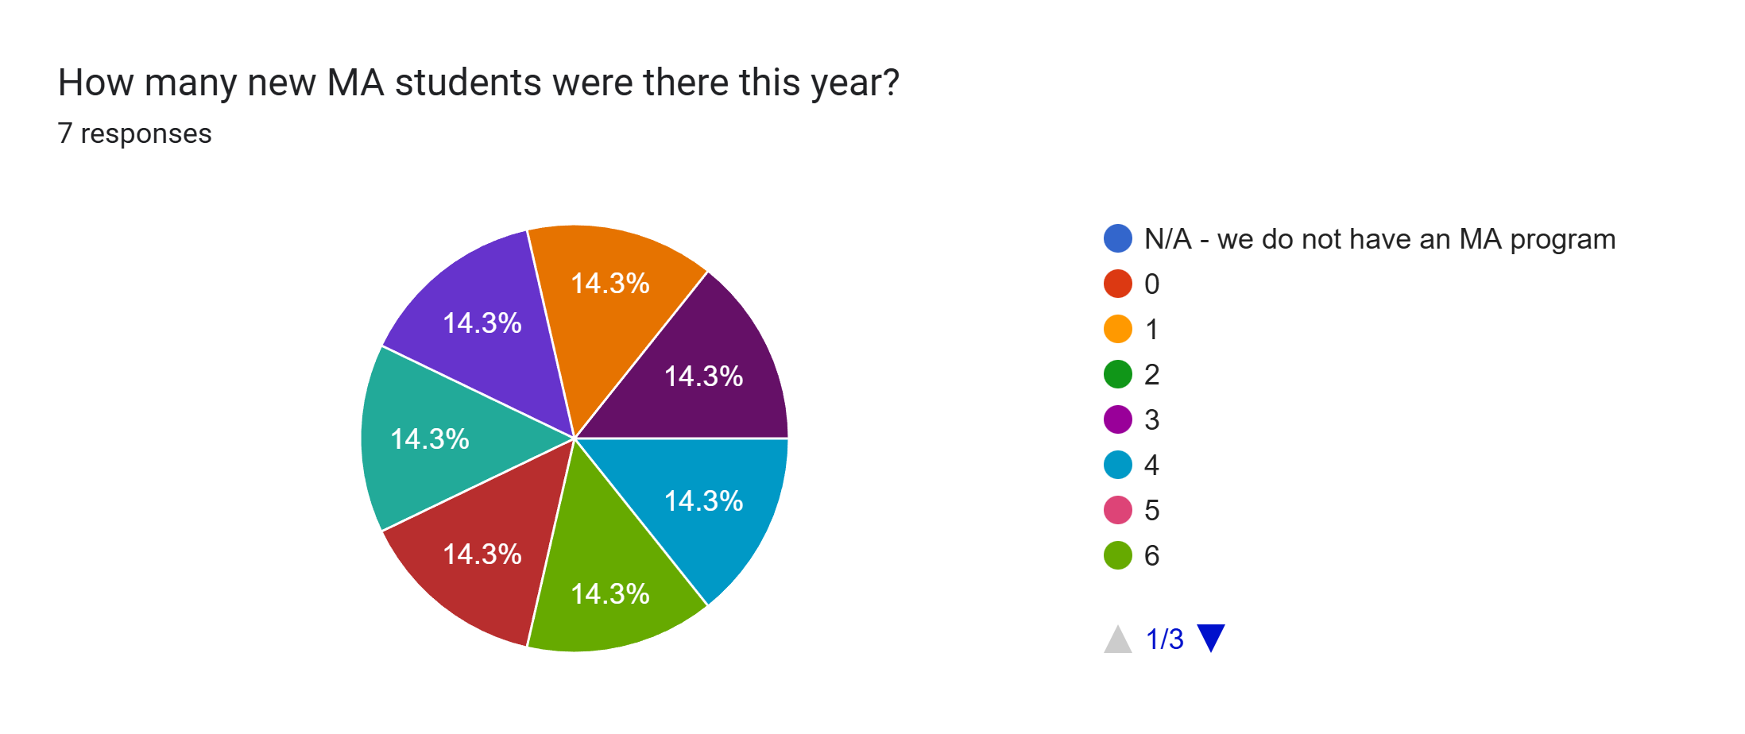

Slide 62
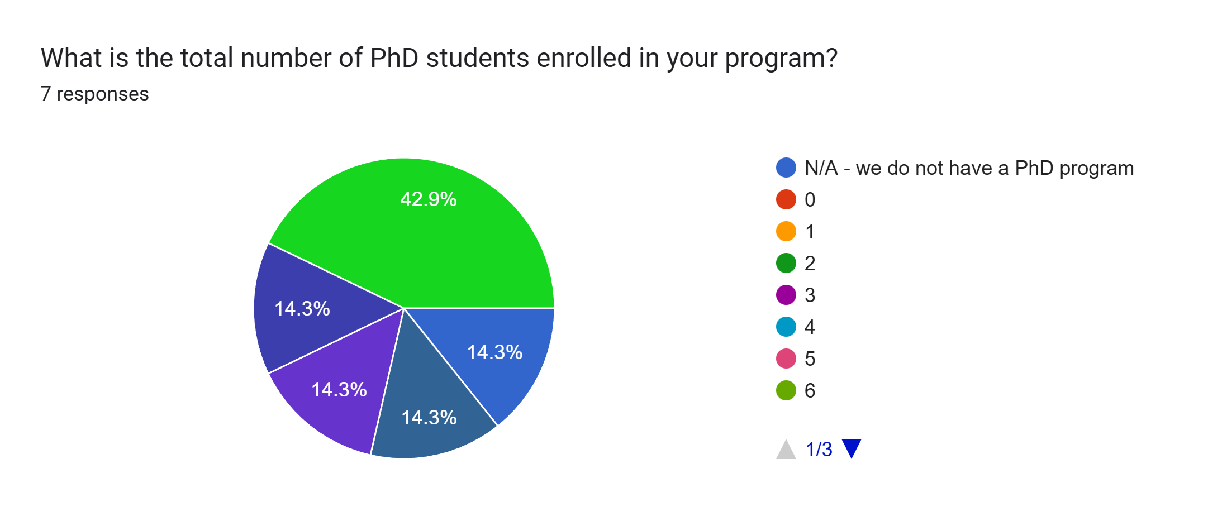

Slide 63
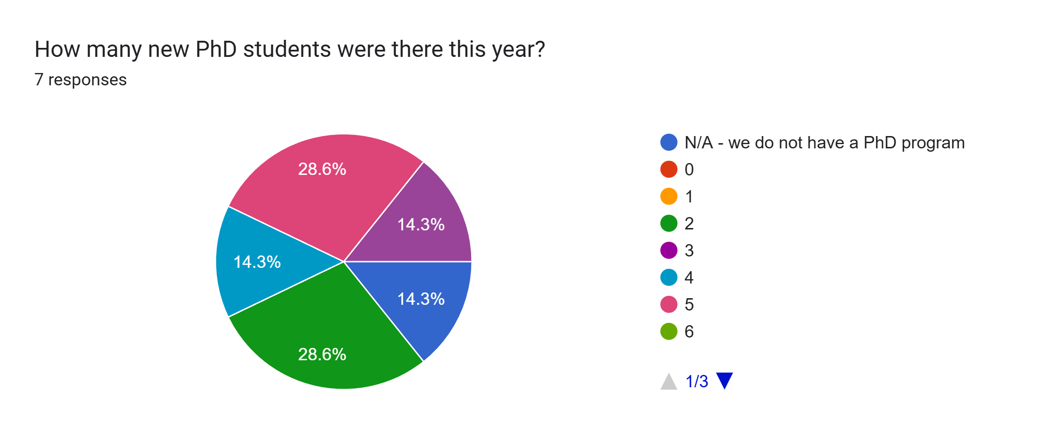

Slide 64
On average, what percentage of the department's grad student enrollments are international students? Is the ratio of domestic and international students similar across PhD and MA cohorts?
b/w 10 - 15%. More at the PhD than the MA.
We are allotted 1 international MA per year, no international PhDs.
almost zero
Around 10%. It's fairly similar between PhD and MAs.
Typically, 20-30% of MA students admitted to the program are international; depending on the year, 25-50% of PhD admissions are for international students. Please note that Master's tuition for international students is just over double the amount for domestic students, but that tuition for Doctoral programs is the same for both groups.
Unknown, as we are a small program within a much larger department.
low percentage - sometimes none in a cohort, sometimes 1-3

Slide 65
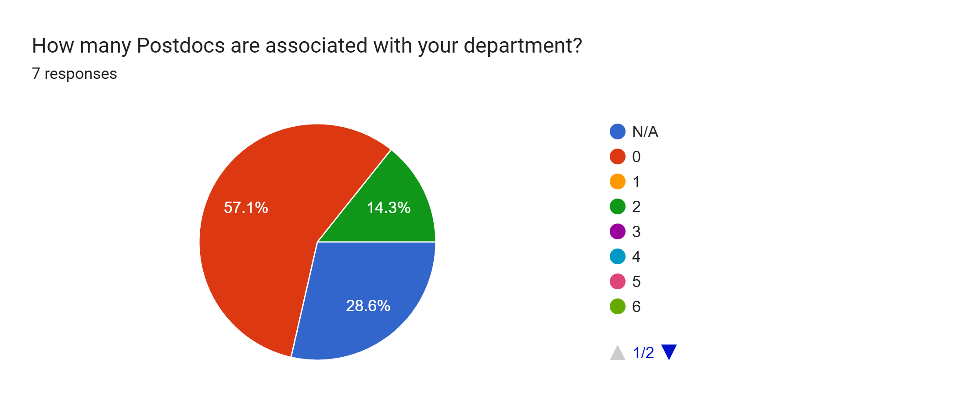

Slide 66
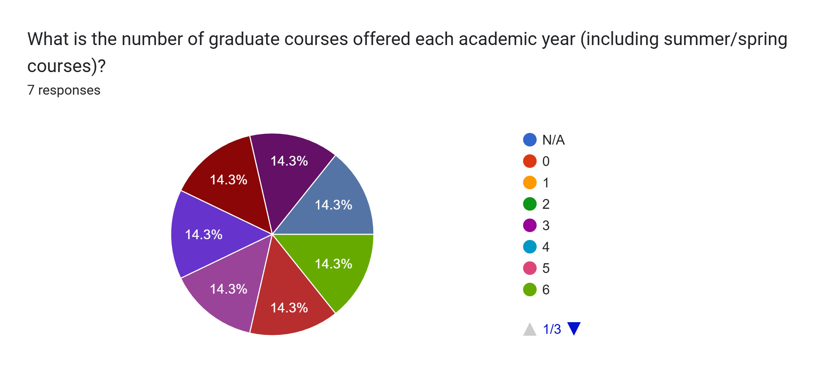

Slide 67
Please break down this year’s courses by area (e.g. 2 Canadian, 1 Victorian, 2 American, 1 Theory). Are there other categories or stipulations you consider when offering grad courses?
2 mandatory courses in methods / dissertation proposals; 1 Canadian; 2 creative writing; 2 victorian; 2 world literature; 2 American; 1 19th century; 1 contemporary; 2 18th century; 1 modernism; 1 theory
even split between literature (varied), rhetoric, and critical media courses to attend to the tripartite nature of our program
for 2025/6: 1 Theory; 2 US (contemporary); 1 theatre; 1 Canadian; 1 sociology (censorship); 1 book arts lab; 1 comparative ... we try to offer 1 course that is pre-18th century ... NB my list here doesn't include summer
1 american, 1 canadian, 2 creative writing, 1 indigenous, 1 gender and sexuality, 1 renaissance, 1 theory
1 Medieval British and Digital Humanities; 1 16th C. British; 1 17th / 18th C. British; 1 Indigenous; 1 Canadian; 1 Transnational / Diasporic; 1 Textual History / Bibliography Our aim is a range of historical periods as well as a reflection of contemporary textual studies approaches.
2 Canadian, 2 American, 2 British/Irish, 2 Postcolonial, 1 Theory, 2 Multidisciplinary, 2 Literary Studies in French (literature, cinema, creative writing, or classics) (optional)
1 Canadian; 1 genre-focused; 1 Renaissance; professional pass/fail; 1 theory

Slide 68
To what extent do you consider the grad courses reflect the diversity of the student body in your department? In other words, are offered courses in alignment with the interests of international students, and students identifying as members of BIPOC or LGBTQ2+ communities?
The program actively encourages course topic and content to reflect the diversity of our student body.
We do not have very many international students; however, recent offerings include 780: Studies in Genre, African American memoirs and slave narratives; 799: Rhetorics of race and identity; 795: The anthropocene, critical theory, race; 775: Insurgent Poetics and Decolonial Praxis in Anglophone World Literature and Media; 770: Black lives matter; 720: The trans eighteenth century
they are fairly aligned
We have developed several new GSL and BIPOC courses for recent and upcoming years
We reflect both a commitment to Indigenous Literary Studies, being located on Treaty Six territory and traditional Metis homeland, and to decolonizing, transnational, and diasporic literatures that reflect Canadian identities within and beyond national boundaries. While our graduate students are well supported in their work on LGBTQTS+ literatures and studies--i.e. through partnerships with Women's and Gender Studies; through SSHRC funded (e.g. Vanier scholarship)--our current courses reflect a gap: our faculty complement has capacity in the field, and our students have access to the Neil Richards Collection of SExual and Gender Diversity, but there is no scholar dedicated to the field itself.
We offer a diverse curriculum.
Yes - and there is great leeway among faculty to meet the interests of students in fulfilling both course work and projects.

Slide 69
How effective and efficient are the library services for grad students in your institution? Over the past few years, is accessing physical copies of books and materials becoming more difficult? How aware of interlibrary loans are grad students?
The program works closely with a subject librarian; no issues have been raised.
While accessing physical books is harder, accessing virtual copies is much easier, and the library is responsive in purchasing books that we make clear that we need. All grad students are aware of ILL and our region is fabulous at getting titles to folks in 1-2 days.
I haven't heard many complaints. Our library is quite good. Students know about ILL and are encouraged to use it.
The library services at [Redacted] for graduate students are overall excellent. The university has an effective inter-library loan service that students can use to bring in texts that are unavailable at [Redacted]. All of our students participate in a two-hour library orientation session, in which they learn about the library’s services, including inter-library loans.
We have an outstanding Librarian for the Department of English: responsive, involved, and engaged. Both physical and e-copies of texts can be ordered by students as well as faculty. Interlibrary Loan services are easily accessible, and while our Special Collections are undergoing renovation, there has been clear communication regarding access.

Slide 70
Do you think your institution's mental health facilities and well being initiatives are adequate for the needs of graduate students? Does your department offer additional workshops too?
Student mental health is an ongoing concern. The program works closely with the institution's Student Accessibility Services to address individual concerns. No additional workshops have targeted this area.
We have just been made aware that the university has made additional hiring in this area and there are currently no wait lists for mental health supports. Students are made aware of this during orientation and throughout professional development events.
We don't offer additional workshops but we direct students to resources. There is an incredibly amount of mental health focus at [Redacted]. At the same time, demand outpaces supply.
Our department offers a session on [Redacted]’s mental health resources for all first-year graduate students. We also go over common challenges faced by graduate students, especially imposture syndrome. [Redacted], like many universities, doesn’t have enough counsellors to meet student needs, which means that students sometimes have to wait for service. However, they have an excellent Student Intervention Team that can step in and help students who are in crisis.
There is a network of supports available, and the Department's role is to explain those supports, engage students in connecting with those supports on formal and informal levels, and remind students at key points in the year of the services available. The Student Wellness Centre offers medical support (access to physicians, access to counselling, access to massages etc.). It is complemented by Student Affairs and Outreach, which enables students to connect with social workers through appointments but also through emergency drop-in accessibility. It supports students with financial questions, wellness issues, and navigation of other university services--including those pertaining to immigration or student visas through our International Student and Study Abroad Centre. On the academic side, Access and Equity Services enables graduate students to request accommodations. In keeping with (and extending) the policies of the College of Graduate and Postdoctoral Studies, the Graduate Chair encourages students with accommodation needs to participate as early as possible in their degree in an Accommodation Planning Committee to establish a path through the degree requirements that would be supported by AES.
The university has a dedicated service for students, Le Centre d'aide aux étudiants. Our Faculty also has a dedicated service worker, L'intervenante de proximité soutient la communauté étudiante, for our students. However, I do not know whether students find these services adequate or not.
No, the department does not offer workshops but the university has resources and since it is a small program, students receive individual support.

Slide 71
Is there any answer that you made in this section that you would like to expand upon?
no
We do not currently have any postdocs in the English program, but the Département de littérature, théatre et cinéma employ several postdocs.
No

Slide 72
II. Specific Program Requirements

Slide 73
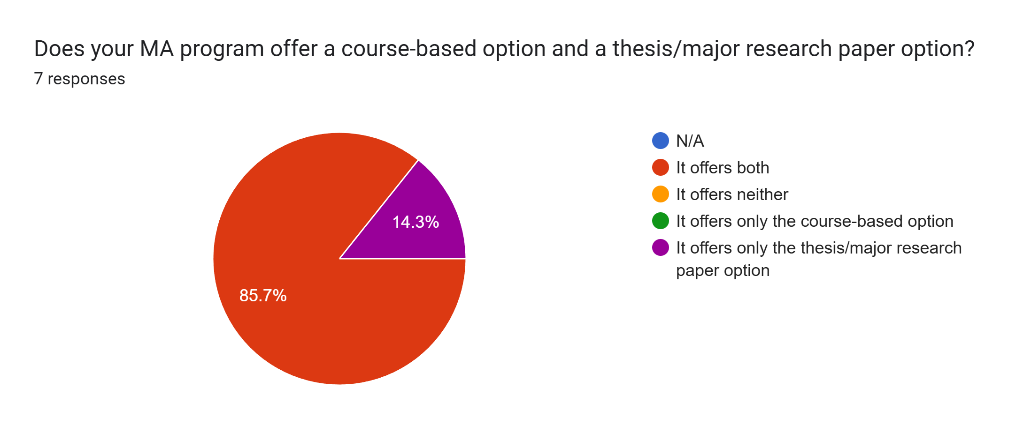

Slide 74
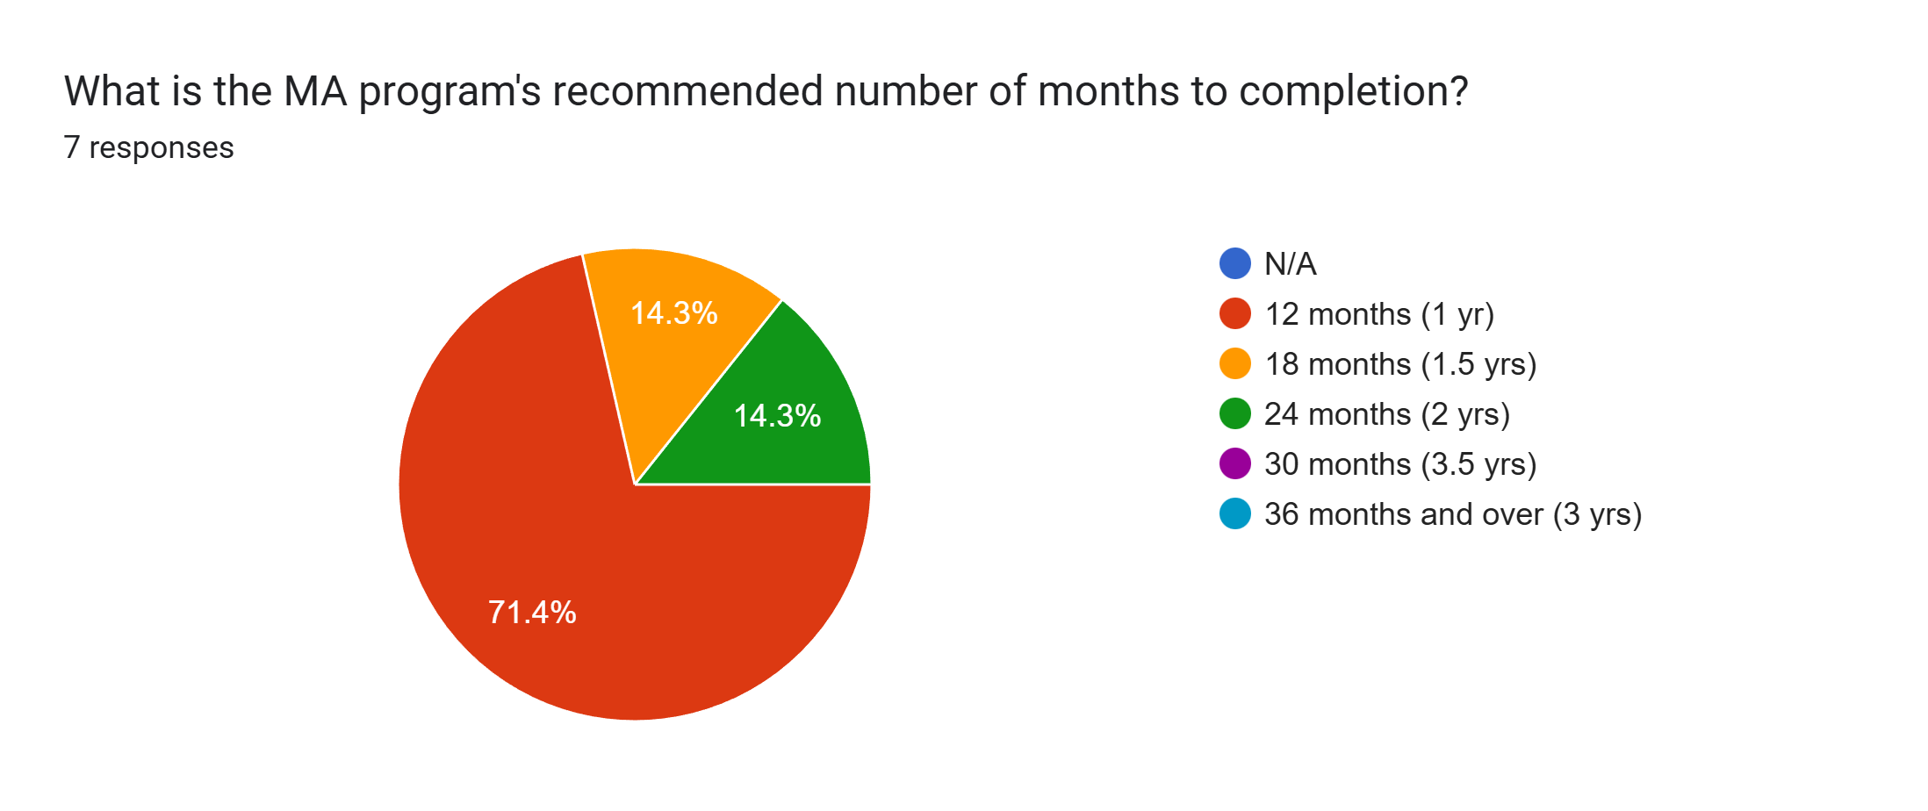

Slide 75
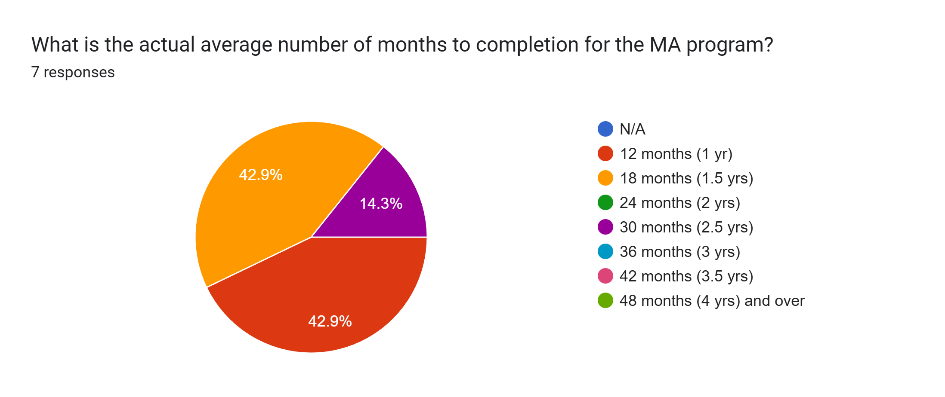

Slide 76
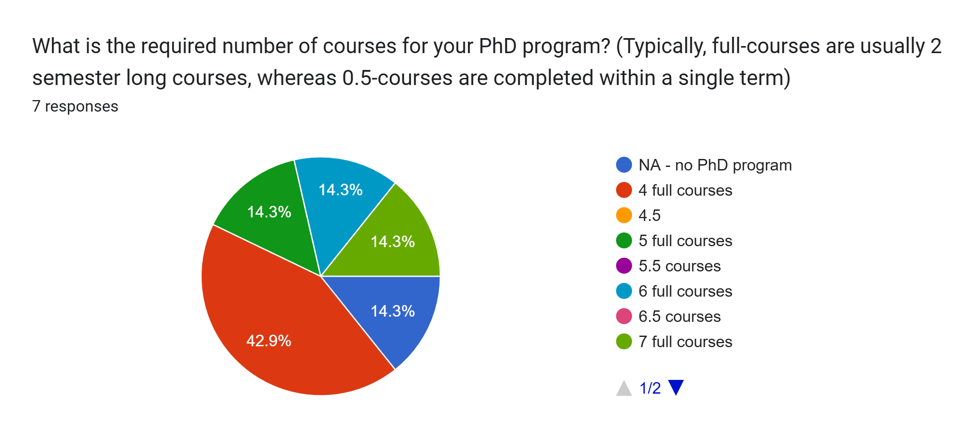

Slide 77
What are the requirements to becoming a PhD candidate in your program (e.g., courses, comprehensives, proposal, field/candidacy exams, thesis, oral defense, prospectus, sample chapter, etc.)?
8 half-courses; major field exam; dissertation list discussion; language requirement; dissertation proposal
coursework, professional development milestone, comprehensive exams and dissertation proposal (written plus oral), language proficiency, dissertation, dissertation defence
course work; comps; (written 4 hour exam plus oral); diss proposal (20 to 25 pages) plus oral; second language
5 courses, 1 methods course, teaching apprenticeship, 2 comprehensive exams
5 (0.5) electives courses; Research Methods (0.5 course); Field Examination (written and oral); Doctoral Candidacy Assessment (dissertation proposal and presentation). Following the latter, the PhD Candidate would present a Works in Progress talk, and submit and defence the dissertation.
Entry requirements: MA in English literature or related discipline, GPA 3.66/4.33 or A-, abbreviated research proposal, supervisor attached at the time of application Requirements before advancing to the thesis write-up stage: 4 literature seminars, 1 research methods course, 2 doctoral/comprehensive exams (including an oral defense), thesis proposal (prospectus)

Slide 78
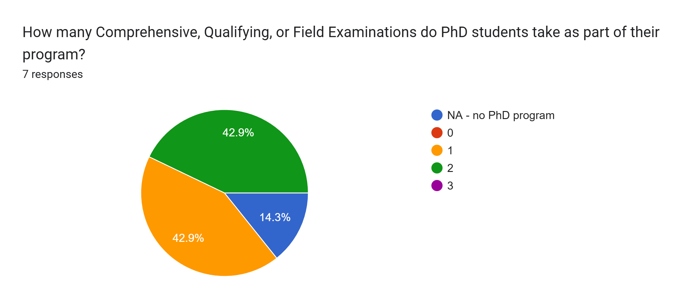

Slide 79
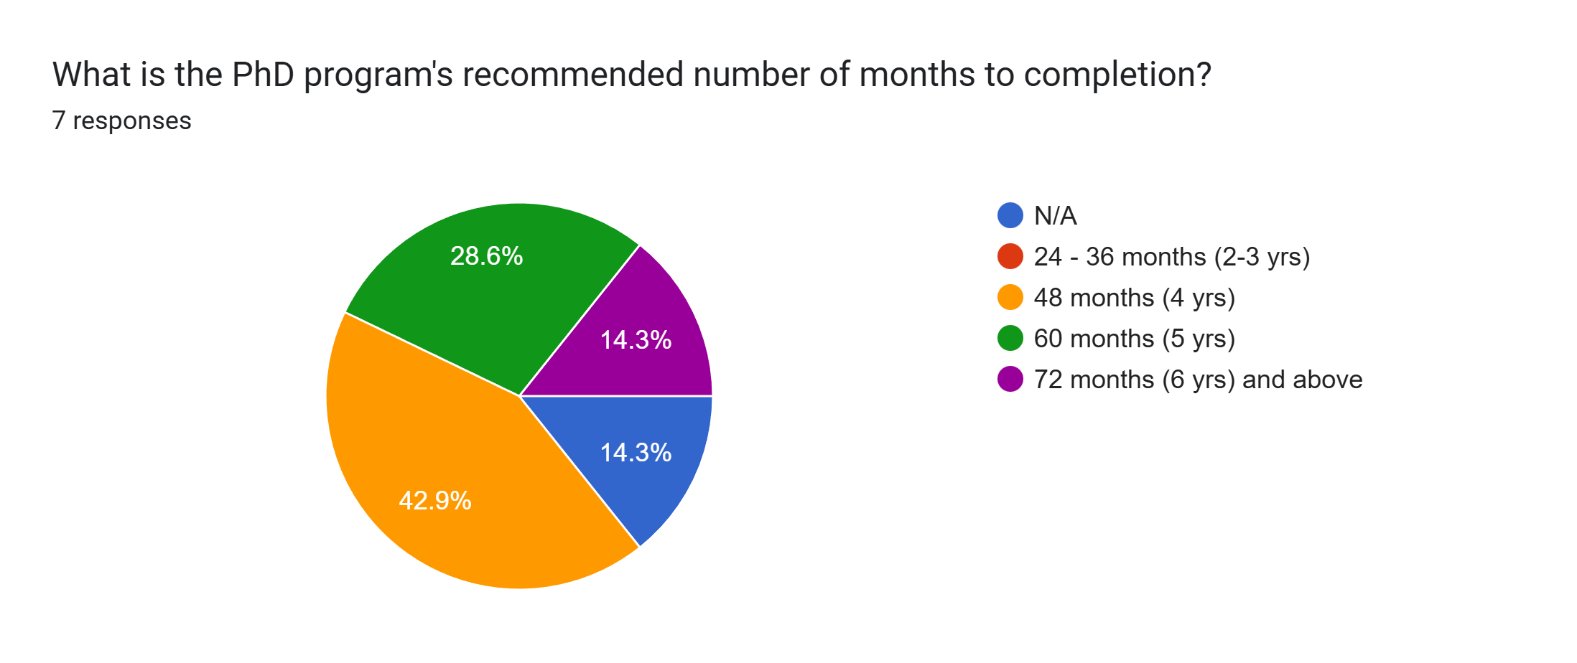

Slide 80
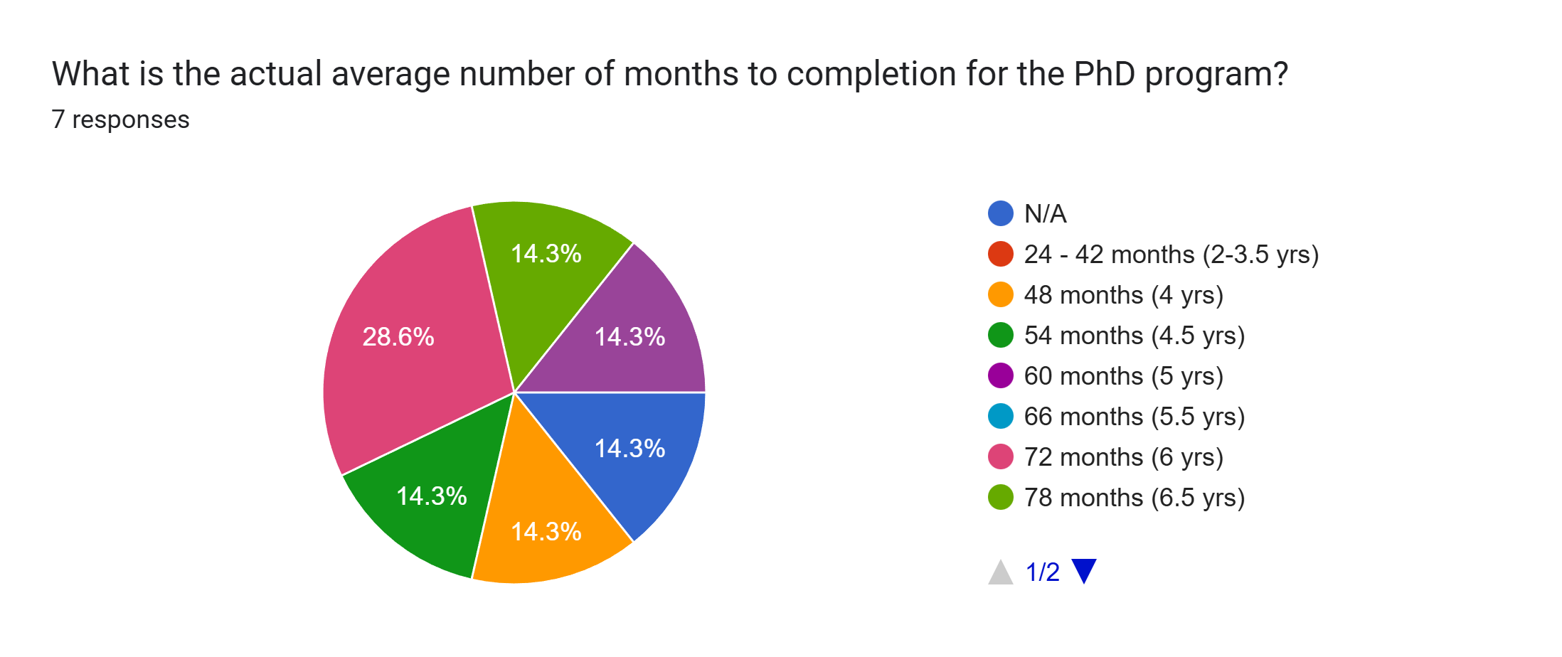

Slide 81
Is there any answer that you made in this section that you would like to expand upon?
Our program has just 1 field examination, but a secondary field reading list & discussion in support of the dissertation itself. (Not a second exam). Months to actual completion varies widely and is difficult to average.
Average time to completion for the PhD is 4.7 years
course requirements are actually 3.5
no
Given that we offer two MA programs, the time to completion is multiple. The accurate response, then, is: - Expected time to completion for Master's Project-based degree: 12 months; actual completion time: 12-14 months - Expected time to completion for Master's Thesis-based degree: 24 months; actual completion time: 24-28 months The courseload question for the PhD program does not provide enough scope or variability for responding. Our students are required to complete 5 elective courses, each lasting one term or semester, and 1 required course, again lasting one term or semester. This would correspond to 3 full courses--an option not provided in this survey. We have altered our PhD program significantly in response to the time to completion rates. In establishing a deadline of 24 months for the Candidacy Assessment, our aim is to enable students to complete the degree within four years, but to take five years in order to hold Teacher-Scholar Doctoral Fellowship, which is part of a professionalization arc.
N/A
time completions for the MA differ according to stream - we have four streams including an internship and research creation; thesis students get 2 years and most finish in 2-3; internship students have 18 months and finish within that time.

Slide 82
III. Funding and Support

Slide 83
What is the current tuition cost, per term? Please indicate if there are differences between MA and PhD costs, or between MA coursework and thesis/MRP options.
$1732. Same for all degree options, across the duration of the degree
MA and PhD: $2,254/term
about $6800
$10,388.50 total for Fall/Winter/Summer, about $3,500 per term.
$1,726.00 for each of three terms. The tuition is the same for domestic students in the MA and PhD programs. Note: the tuition for international students registered in the MA is $3,883.50 for each of three terms.
I don't know but there are no differences

Slide 84
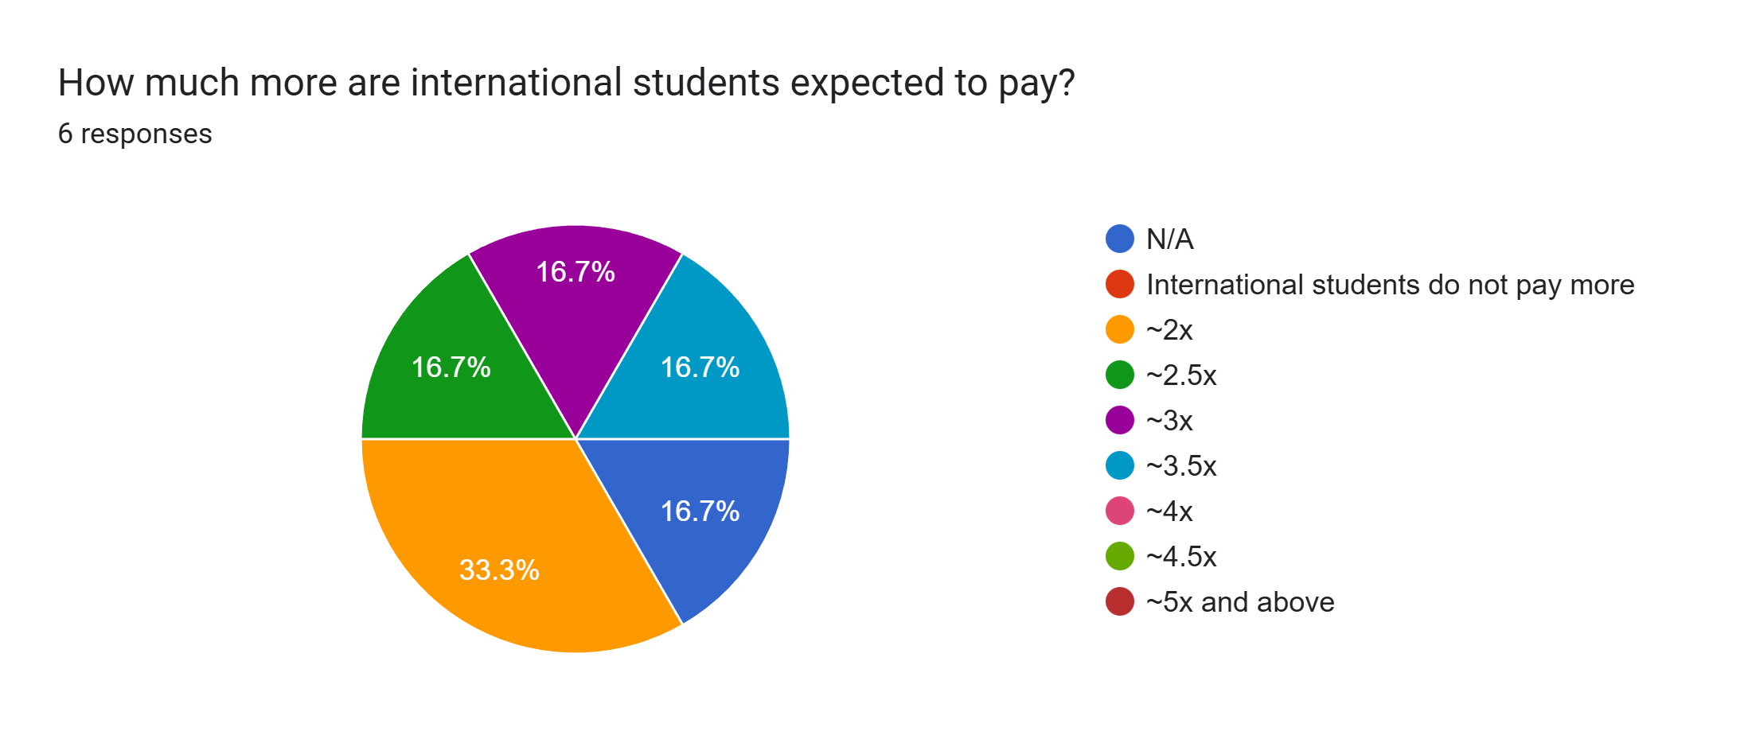

Slide 85
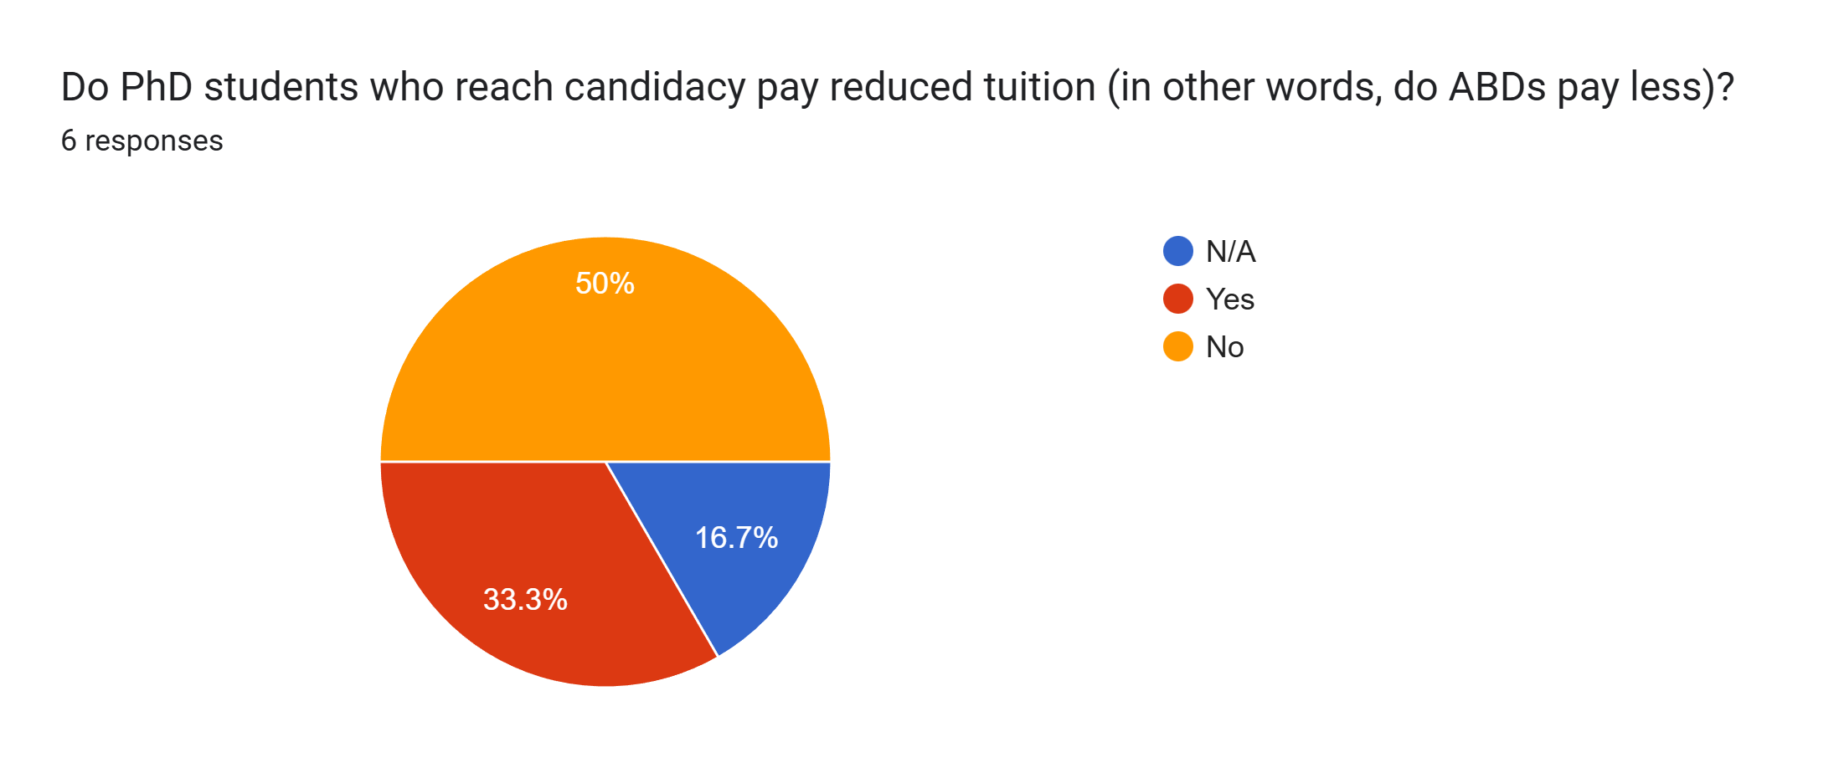

Slide 86
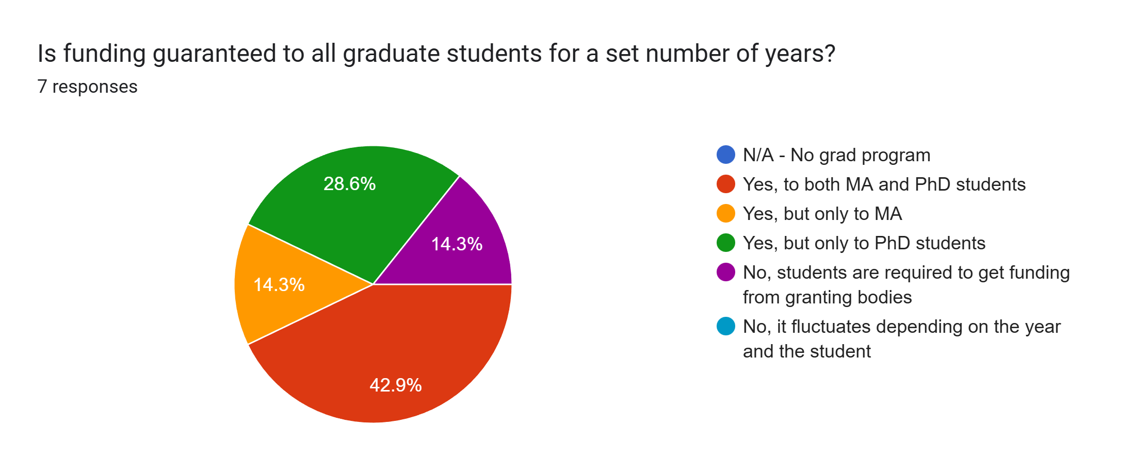

Slide 87
If you answered 'yes,' for how many years (please distinguish between MA and PhD, if there is a difference)?
1 year for MA, 6 years for PhD
MA: 1 year; PhD: 4 years
MA 1 year; PhD 5 years
PhD - 4 years
Minimum $20,000.00 per year for four years for PhD students. Typically, the amount is $25,500 per year. For MA students, there is no guaranteed minimum, but typically they receive $21,100 for the first year..

Slide 88
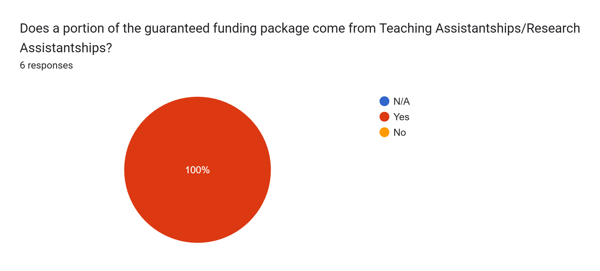

Slide 89
Does the reception of provincial/federal awards (e.g. OGS, SSHRC) affect a student’s internal funding (such as Teaching Assistantships)? If 'yes,' how so?
Yes: PhD students will have a portion of their fellowship reduced.
Yes. They are not required to teach if they have SSHRC, so the equivalent funding is removed from their package.
no
Yes - it replaces dept/faculty assistantship
TAships would remain constant, while the scholarship portion of the funding package would be replaced by the CGS-M or CGS-D. In addition, there would be a $6,000 top-up for CGS-Ms and a $7,500 top-up for CGS-D recipients. For Indigenous students, a $5,000 top-up is available.
No, not the teaching assistantship.

Slide 90
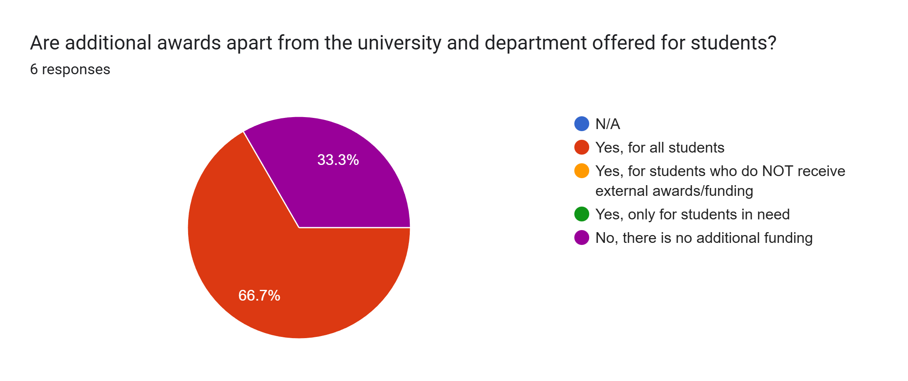

Slide 91
Are there awards/bursaries available for international students who do not qualify for SSHRC or certain University or Departmental donor awards etc.?
Yes, a limited number of competitive awards can be applied for.
No
a few
yes
Yes. Bursaries are available for all students.
Yes - some

Slide 92
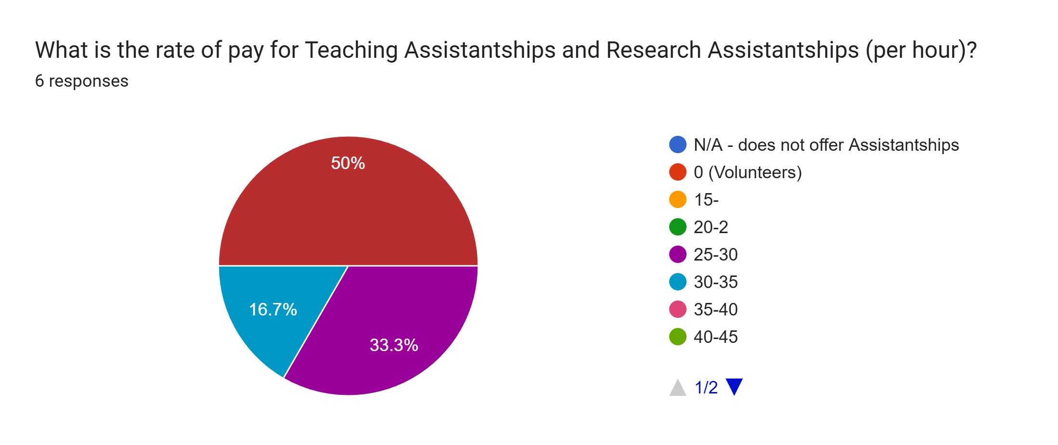

Slide 93
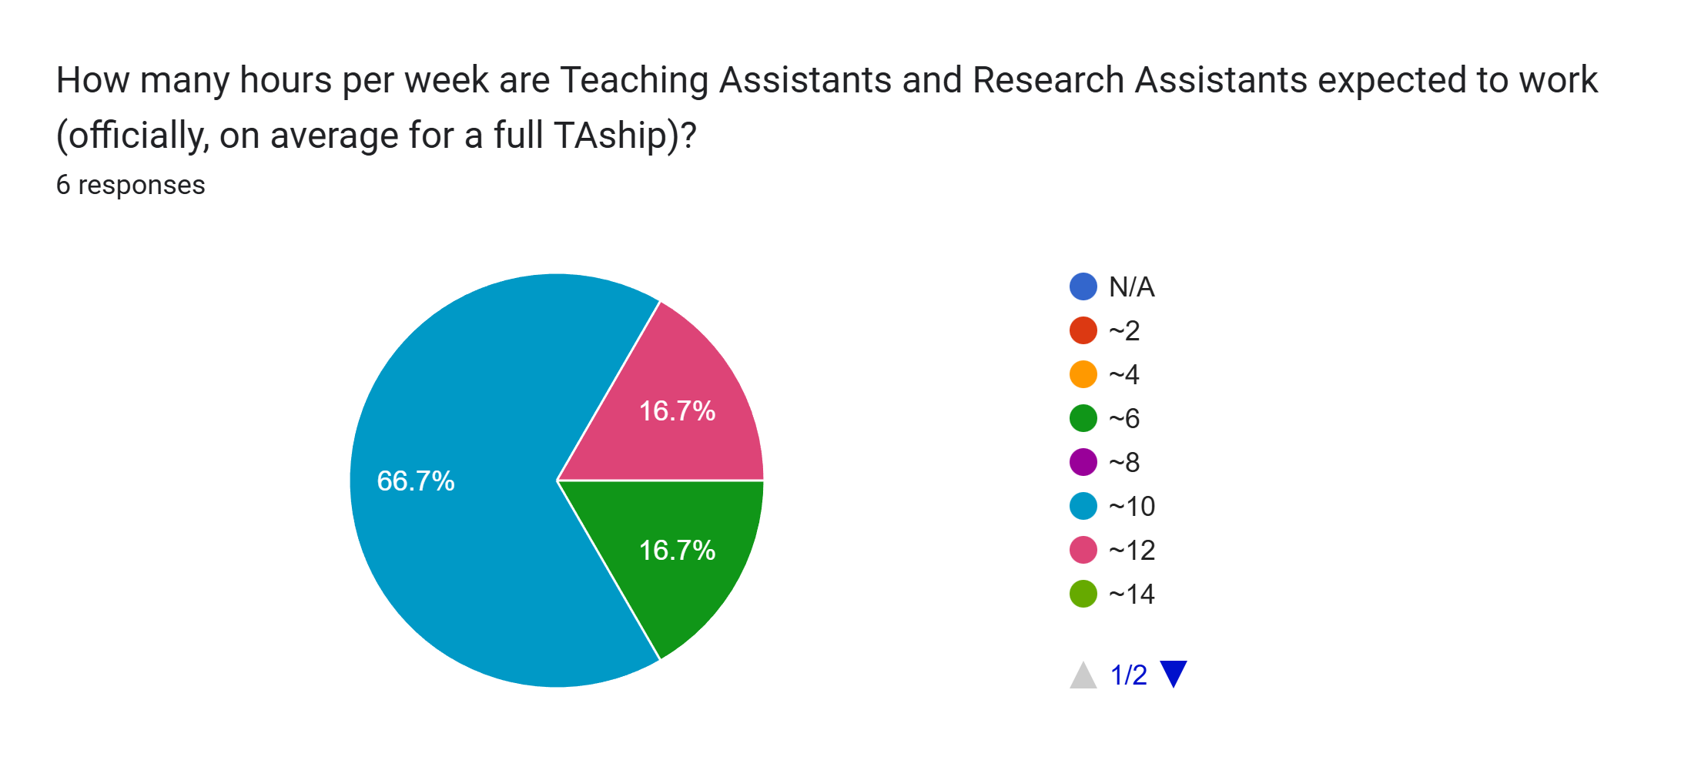

Slide 94
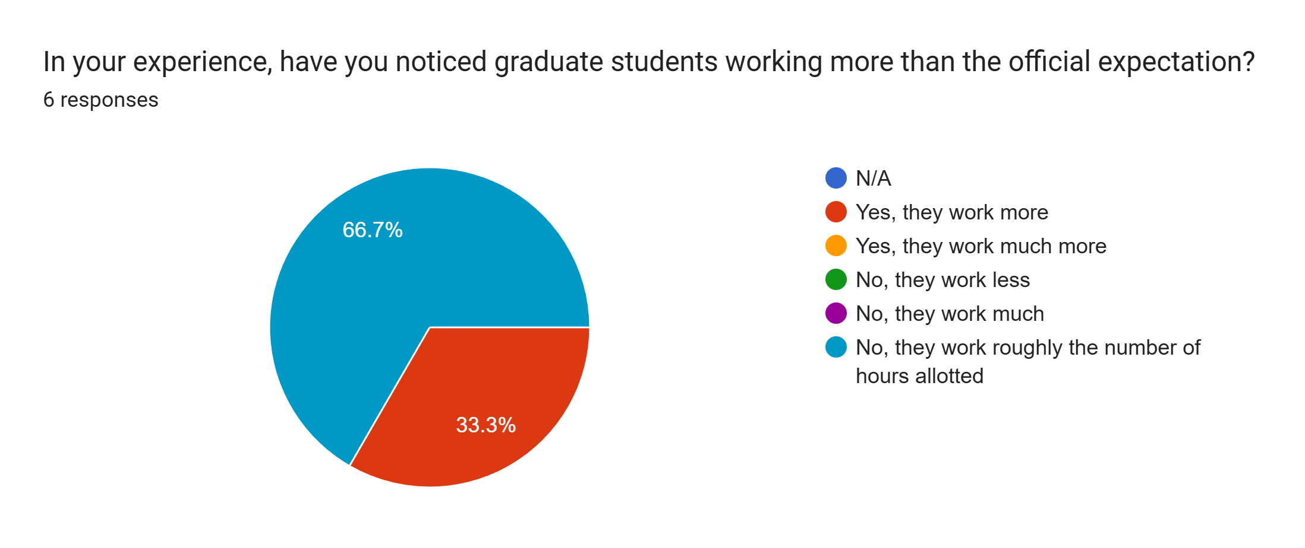

Slide 95
In your experience - or as far as you are aware - roughly what percentage of the grad students in your department have part-time jobs outside of TA/RA-ships to pay for academic and living expenses? Do you think there is a gap between such expenses and the funding available to grad students?
Yes, I am aware that many students work additional jobs; yes, there is a gap between living expenses in Toronto and funding available.
nearly 80% have other jobs. There is a huge gap between funding available and cost of living in this area.
about half ... yes, the funding available is not enough, especially at MA level
Student funding, unfortunately, does not meet students’ financial needs. With the rising cost of food and rent, many students are forced to take on part-time jobs to help cover their living expenses. I do not have any data on how many students are working outside the university
At least 65%. While some students work at the Writing Centre for additional hours and further professionalization, we have a high percentage of students who are finishing their PhD degrees and were significantly delayed by the pandemic. For those students in years 7+, a full-time job is necessary. There is a huge gap between the cost of living and the amount of funding we can offer. The department has seen its graduate funding decrease steadily and by tens of thousands of dollars. We have implemented a series of initiatives to support SSHRC success on the part of student and faculty applicants. We have leveraged grants and partnerships and departmental awards. We have tried to meet benchmarks to improve our institutional standing. Even though our tuition is not excessive, it's daunting situation, as we balance the needs for a rigorous program with the need for students to progress efficiently through their degrees.
I don't know

Slide 96
Is there funding available through your department for graduate student Professionalization, Research and/or Conference Travel/Accommodation? If, yes, is there a cap on the number of conferences per student per year?
Not through the department, but through the Faculty of Grad Studies
Yes. It is about $200 per year, available, on average, once per year per student (application based)
a little ... yes, there is a cap and the funding doesn't cover the whole cost
Yes, partial funding. There is no cap on number of conferences a student can attend, but there is only so much funding, which we try to allocate equally between students who apply for it.
We offer a small ($300) travel reimbursement for conferences. If there is enough money, we can offer this more than once. There are also awards for research travel, which are competitive, both through the department and the university.
Yes, usually one a year

Slide 97
Do students beyond institution funding period receive the same TA opportunities or conferences/research travel bursaries?
No
They have the same opportunities to apply for travel funding, but are not guaranteed teaching. However, many do get teaching in their 5th year.
no
yes
Certainly for travel, and where possible, TAships and RAships are provided to upper-year PhDs or MA students in their second year.
usually extended by a year

Slide 98
Is there an answer that you made in this section you wish to expand upon? Or do you have any additional comments on the survey?
TA rate is $8020 per term, not including 4% vacation pay.
I strongly encourage them to never overwork their TA hours
no
There is a differential workload for TAs and RAs. MA students work an average of 12 hours / week; PhD students work an average of 16.5 hours / week.
Yes, I am sorry for the later submission. Also I am no longer the Director. Please send this form to the administrative assistant for the program in the future: [Redacted]- she will ensure that the form gets to the current director. Thanks for all the good work the grad students caucus does.

